Slide 1



A National
Wildfire Risk Assessment for
National Forest System Lands
Overview and Results
Wildland Fire Management RD&A Seminar
November 2, 2017
Greg Dillon, Rocky Mountain Research Station, Fire Modeling Institute
Frank Fay and Jim Menakis, Washington Office, Fire and Aviation Management

Slide 2

Why a National Risk Assessment?
  Recommendation 1:
    Fully develop and implement a national risk assessment model for identifying and prioritizing hazardous fuels reduction projects on National Forest System lands.
  Agency Response:
    … The national office is developing a national risk model that will be used to identify and prioritize hazardous fuels reduction areas. The results will inform allocation of resources to the regional level. Projects will be designed based on those priority areas; however the priority of implementation of individual projects is not a national-scale decision.
July 2016 USDA OIG Report
Notes:
OMB, OIG, and others want to know what they’re getting for their investments in a hazardous fuels program. The FS needs a consistent and credible tool for talking about fuels management priorities and accomplishments at a national scale.
Risk assessment can inform budget and resource allocation decisions… but only one piece of information
Risk assessment helps to align national policy and management direction with cohesive strategy goals:
Restore and maintain resilient landscapes
Create fire-adapted communities
Improve safe and effective fire response\
Risk assessment provide a scientifically-based and spatially-specific communication tool to convey
Potential risks and benefits of wildfire on NFS lands
Fuels management priorities from a national perspective

Slide 3
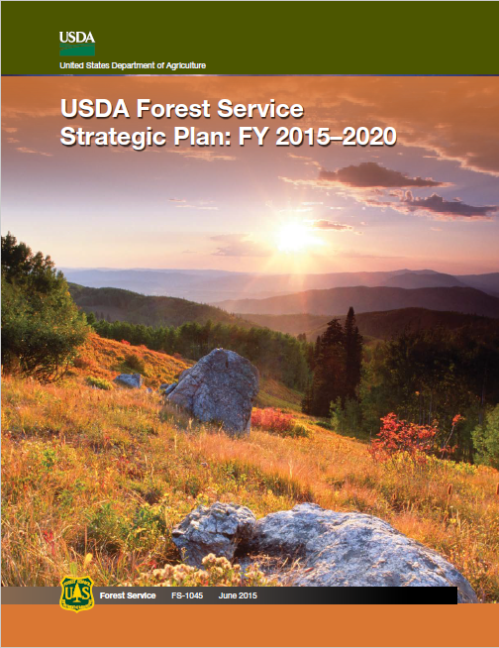
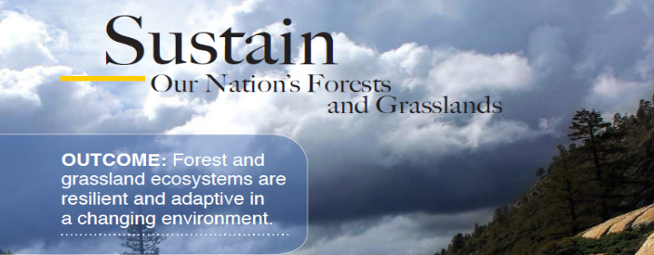
Why a National Risk Assessment?
  Strategic Objective B:
    Mitigate Wildfire Risk.
  Fire and Aviation Management Briefing Paper, December 2016:
    How can the Forest Service monitor performance towards mitigation of wildfire risk on National Forest System lands (Strategic Plan Objective B)?
    …FAM has developed a wildfire risk index based on the Probability and Intensity of wildfire and the Exposure and Susceptibility of Highly Valued Resources and Assets (HVRA). The index is based on national-scale datasets.
    … The Risk Index will track changes over time based on a statistically sound and repeatable process.
Notes:
The first Strategic Goal in the FS Strategic Plan is to “Sustain our Nation’s Forests and Grasslands”. Under that goal, Objective B is to Mitigate wildfire risk. We asked ourselves, “How can we measure the progress toward that objective?”
Note that “mitigate” specifically means “to make less severe” or to “lessen the gravity of.” Therefore, we focused on the measuring of the negative effects of wildfire because the positive effects of wildfire are already mitigating the risk and should continue to be encouraged..

Slide 4
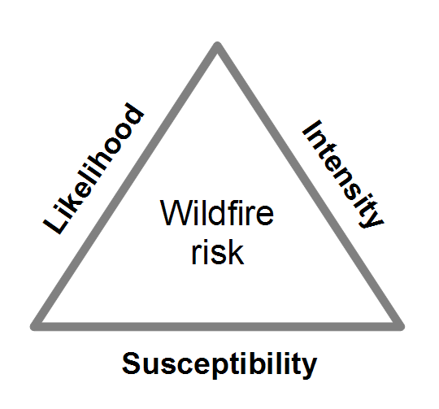
Overview of Wildfire Risk Assessment
What is the wildfire risk assessment?
  Three fundamental components:
    Fire likelihood, fire intensity, and fire effects – all in a spatial context
  Scott et al. 2013
  RMRS-GTR-315
Wildfire Simulation Modeling

Slide 5
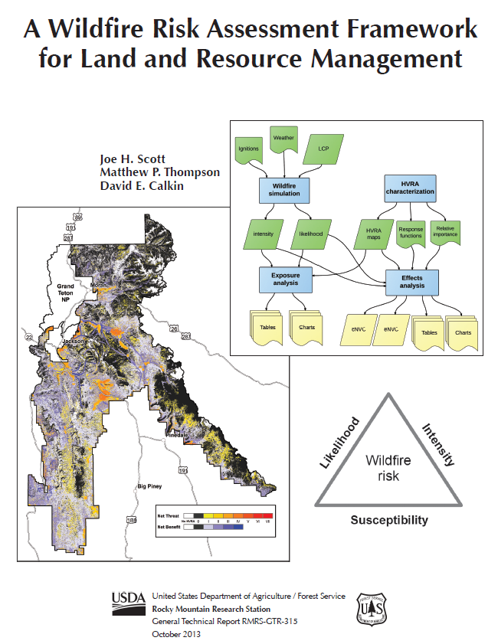
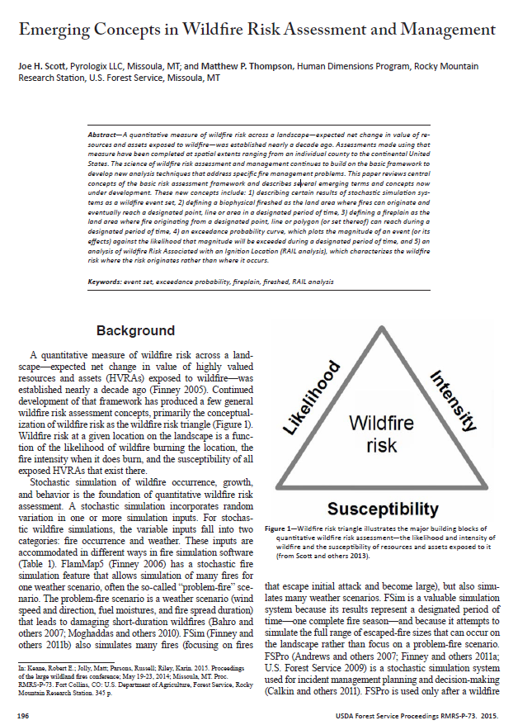
Quantifying Risk
Expected Net Value Change: E(wNVC)
  w term introduces a weighting factor based on relative importance and relative extent
Conditional Net Value Change: cNVC
  Considers only conditional probabilities for each intensity level
  Expected loss or gain should fire occur
Can pull out benefit and loss separately

Slide 6
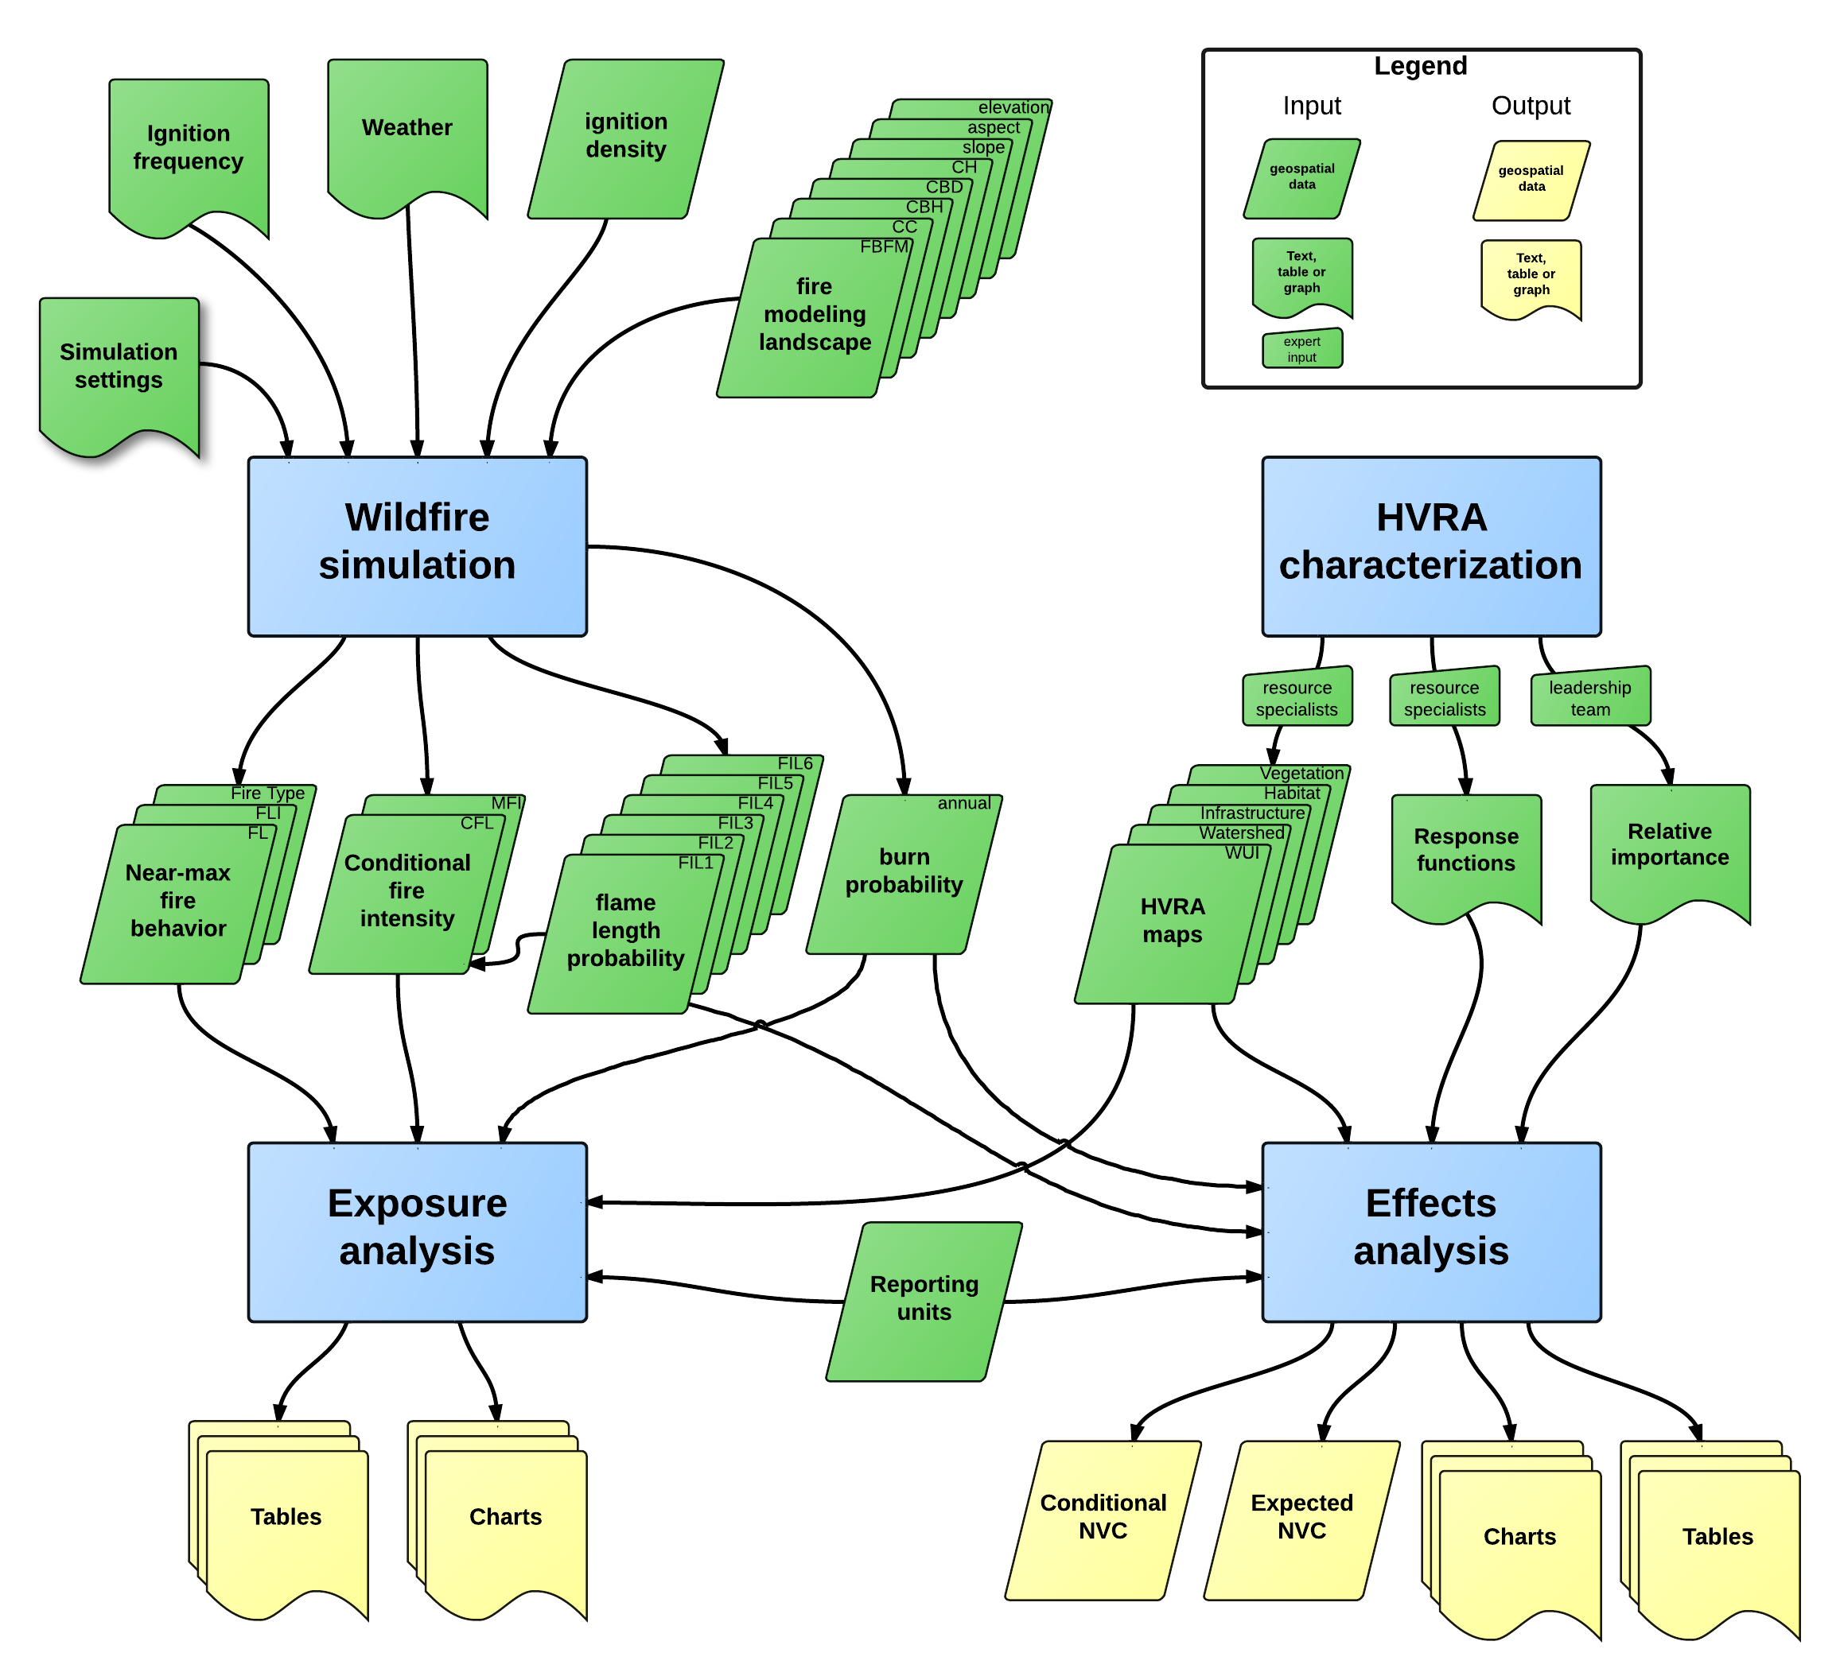
Overview of Wildfire Risk Assessment
Figure from Scott et al. 2013
Notes:
This overview diagram of the risk assessment process shows the four primary phases of a risk assessment and the various inputs and outputs. It’s useful for structuring the presentation of information that went into this risk assessment. The next set of slides will walk through some of the data and information used in the wildfire simulation and HVRA characterization phases of the assessment and is meant to highlight the variables that ultimately drive the results.

Slide 7
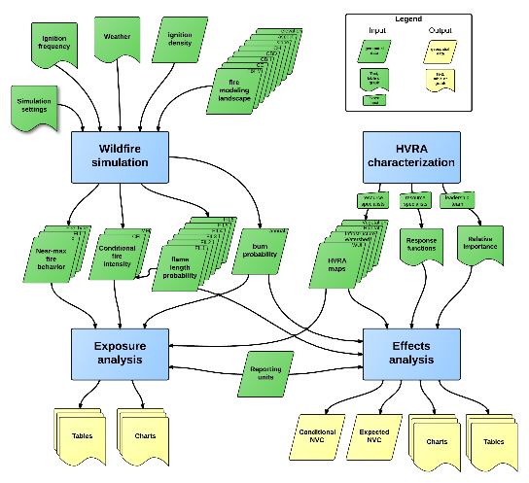
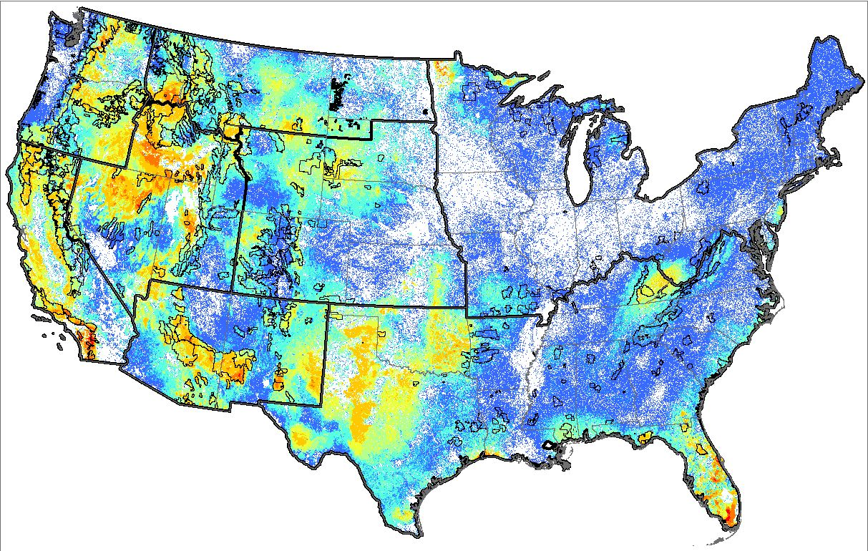
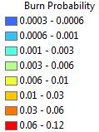
Wildfire Simulation
Burn Probability
  Input landscape is LANDFIRE 2012
  FSim modeling done by RMRS, completed in 2016
  Calibrated to fire occurrence from 1992 – 2013
Notes:
FSim is run separately in each of 128 “pyromes” or modeling regions across the country, then results are mosaicked together
In each pyrome, FSim is run with 20,000 or more fire season iterations across all statistically-possible weather scenarios
Outputs represent a big-picture, long-term, strategic view… not any specific fire season

Slide 8
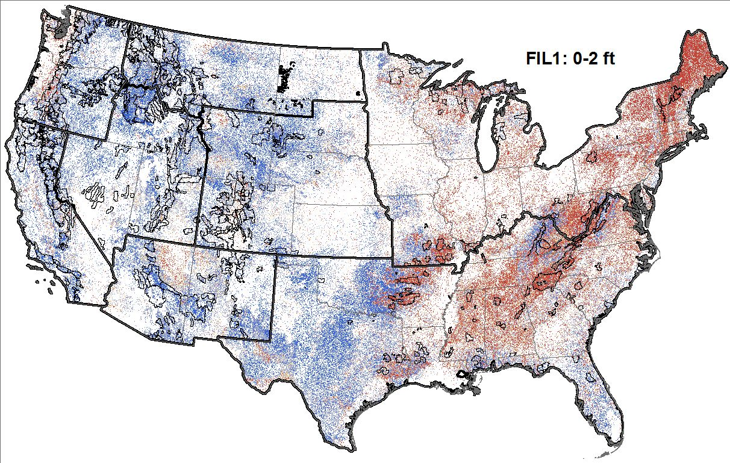

Wildfire Simulation
Conditional Flame Length Probabilities (FLPs)
  Same simulations that generate burn probability
  Flame Lengths grouped into 6 Fire Intensity Levels (FILs)
  Values across all 6 FILs will add to 1 for each pixel
Notes:
As we go through the slides of FLPs, pay close attention to where we have the highest probability of high flame lengths… these are almost always the areas that end up having the highest NVC (or “risk”) values in the results.

Slide 9
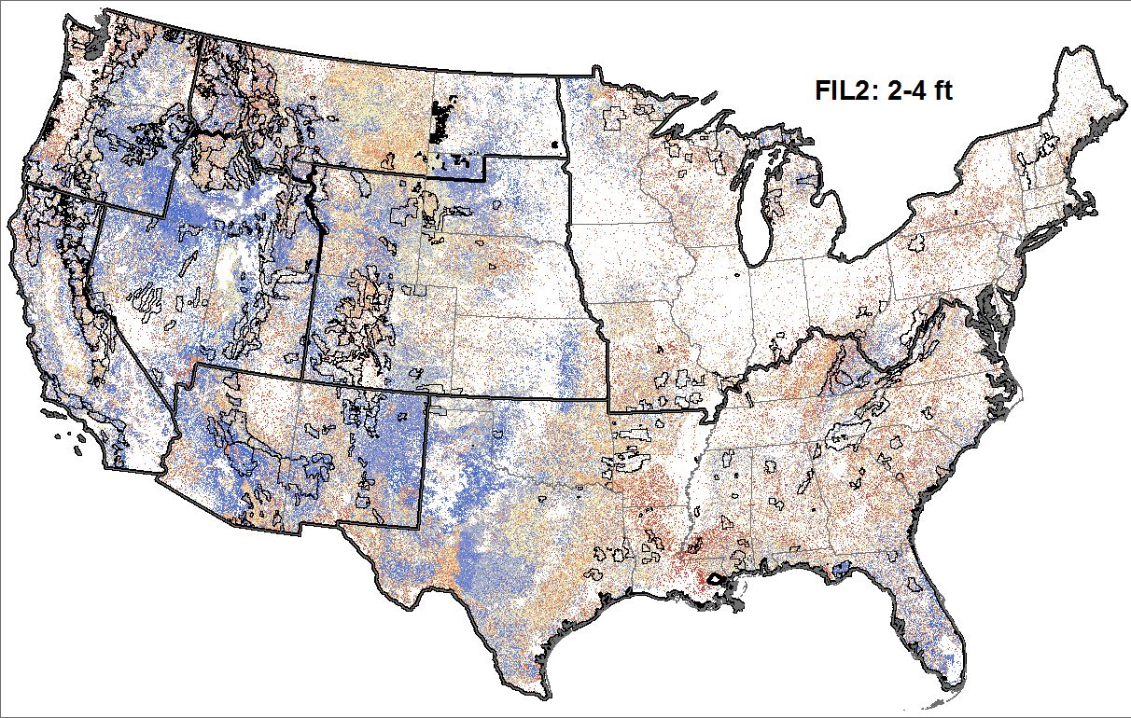
Wildfire Simulation
Conditional Flame Length Probabilities (FLPs)
  Same simulations that generate burn probability
  Flame Lengths grouped into 6 Fire Intensity Levels (FILs)
  Values across all 6 FILs will add to 1 for each pixel
Notes:
As we go through the slides of FLPs, pay close attention to where we have the highest probability of high flame lengths… these are almost always the areas that end up having the highest NVC (or “risk”) values in the results.

Slide 10
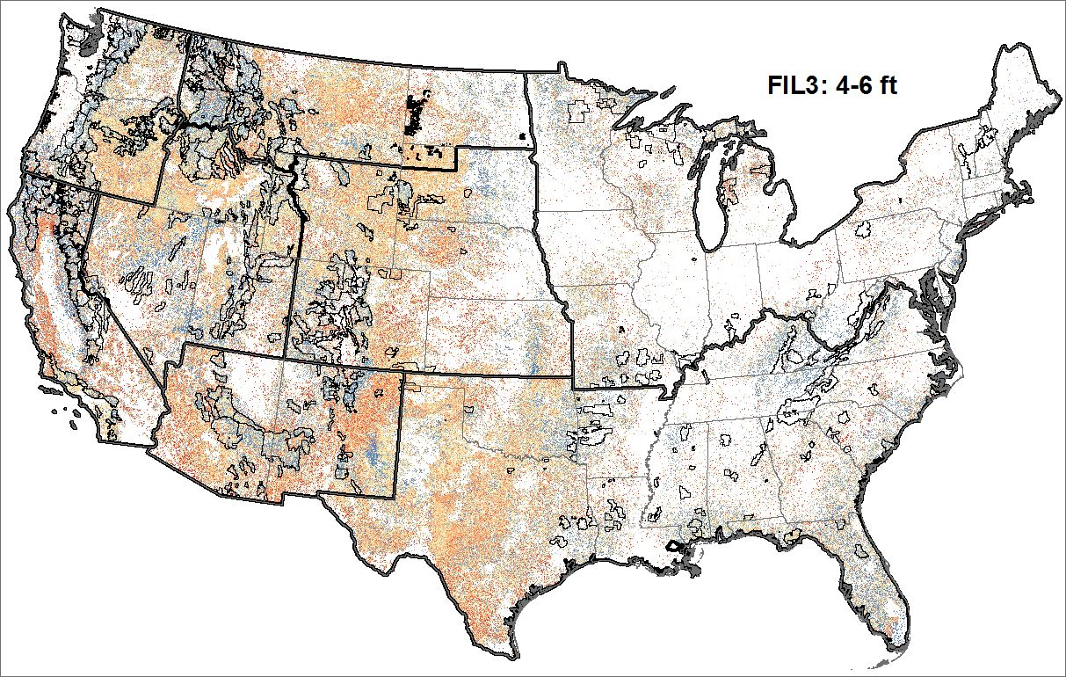
Wildfire Simulation
Conditional Flame Length Probabilities (FLPs)
  Same simulations that generate burn probability
  Flame Lengths grouped into 6 Fire Intensity Levels (FILs)
  Values across all 6 FILs will add to 1 for each pixel
Notes:
As we go through the slides of FLPs, pay close attention to where we have the highest probability of high flame lengths… these are almost always the areas that end up having the highest NVC (or “risk”) values in the results.

Slide 11
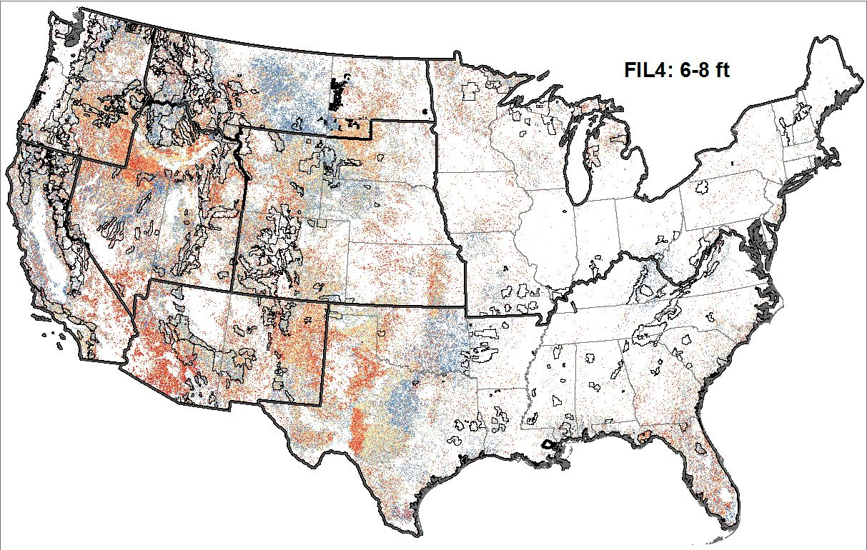
Wildfire Simulation
Conditional Flame Length Probabilities (FLPs)
  Same simulations that generate burn probability
  Flame Lengths grouped into 6 Fire Intensity Levels (FILs)
  Values across all 6 FILs will add to 1 for each pixel
Notes:
As we go through the slides of FLPs, pay close attention to where we have the highest probability of high flame lengths… these are almost always the areas that end up having the highest NVC (or “risk”) values in the results.

Slide 12
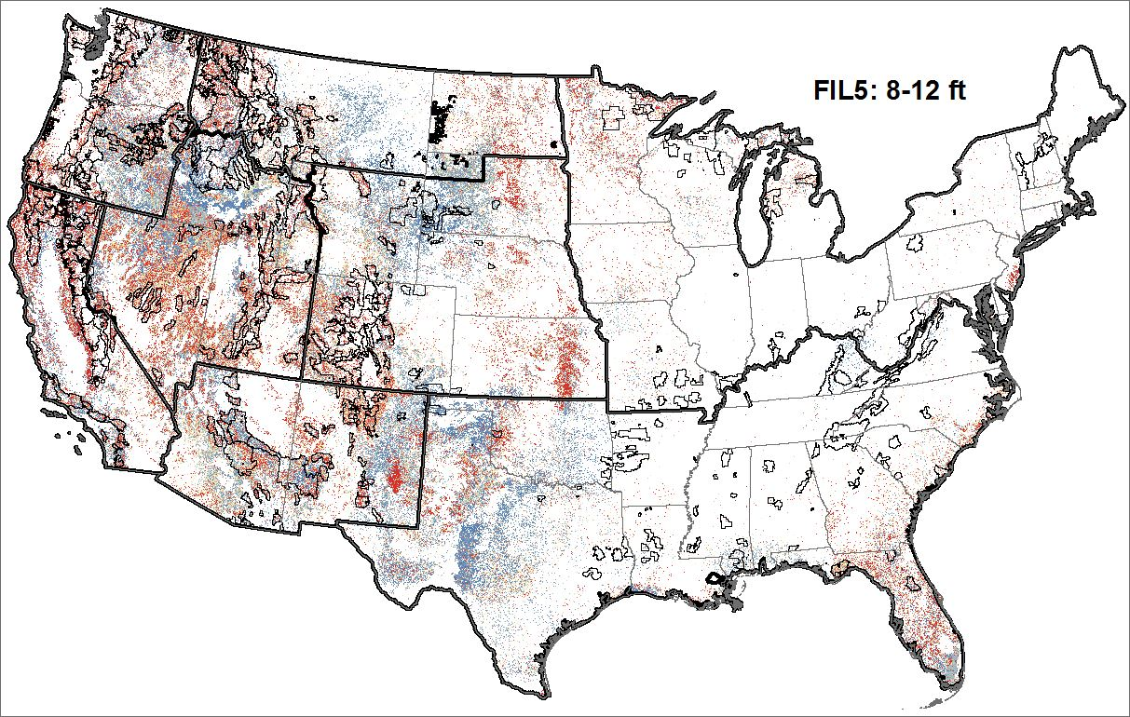
Wildfire Simulation
Conditional Flame Length Probabilities (FLPs)
  Same simulations that generate burn probability
  Flame Lengths grouped into 6 Fire Intensity Levels (FILs)
  Values across all 6 FILs will add to 1 for each pixel
Notes:
As we go through the slides of FLPs, pay close attention to where we have the highest probability of high flame lengths… these are almost always the areas that end up having the highest NVC (or “risk”) values in the results.

Slide 13
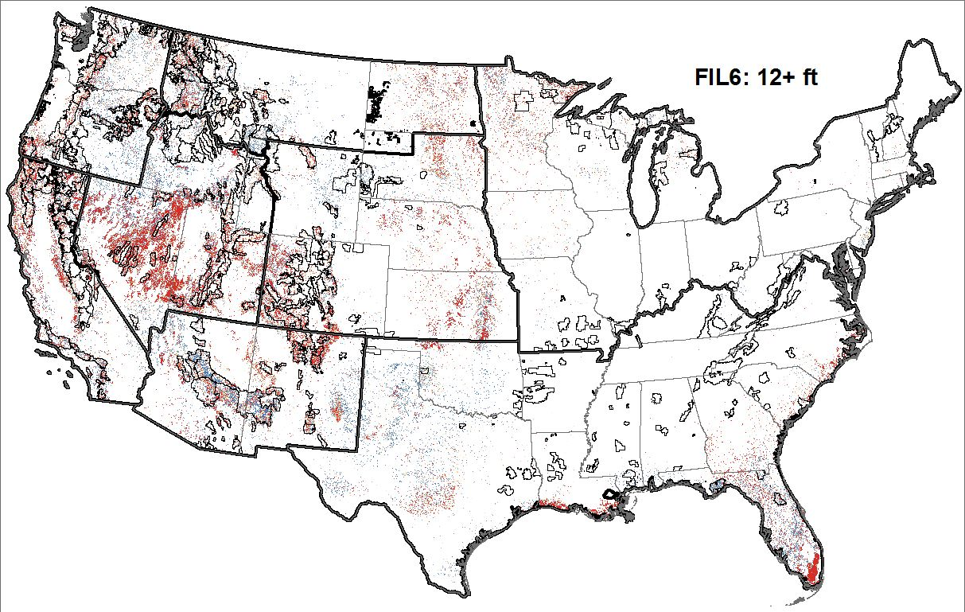
Wildfire Simulation
Conditional Flame Length Probabilities (FLPs)
  Same simulations that generate burn probability
  Flame Lengths grouped into 6 Fire Intensity Levels (FILs)
  Values across all 6 FILs will add to 1 for each pixel
Notes:
As we go through the slides of FLPs, pay close attention to where we have the highest probability of high flame lengths… these are almost always the areas that end up having the highest NVC (or “risk”) values in the results.

Slide 14
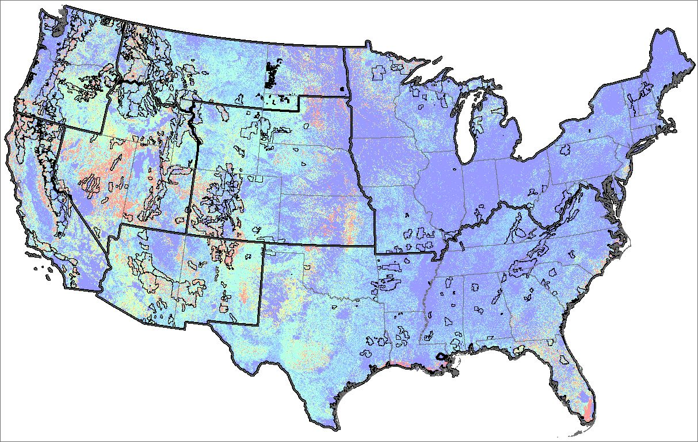
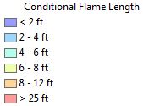
Wildfire Simulation
Conditional Flame Length
  Calculated from the 6 FLP layers
  Represents the average Flame Length for each pixel
  Use in calculating Wildfire Hazard (BP x CFL)
Notes:
As we go through the slides of FLPs, pay close attention to where we have the highest probability of high flame lengths… these are almost always the areas that end up having the highest NVC (or “risk”) values in the results.
The areas with high CFL are sometimes a quick way to see where intensity is having a large effect on results

Slide 15
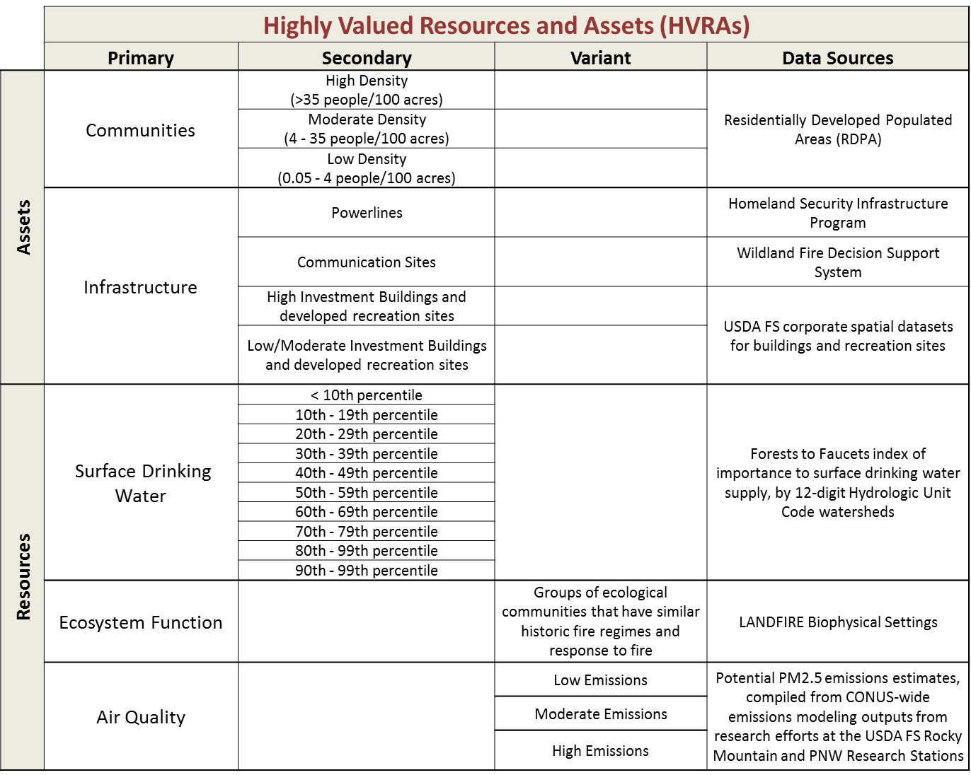
HVRA Characterization
Selected resources and assets with available nationally-consistent data
Notes:
This list represents HVRAs at a coarse, national perspective
We considered many more HVRAs than this initially
A couple HVRAs that are conspicuously absent from this list, and tend to show up in risk assessments at finer scales include:
Habitat for specific species
Timber resources

Slide 16
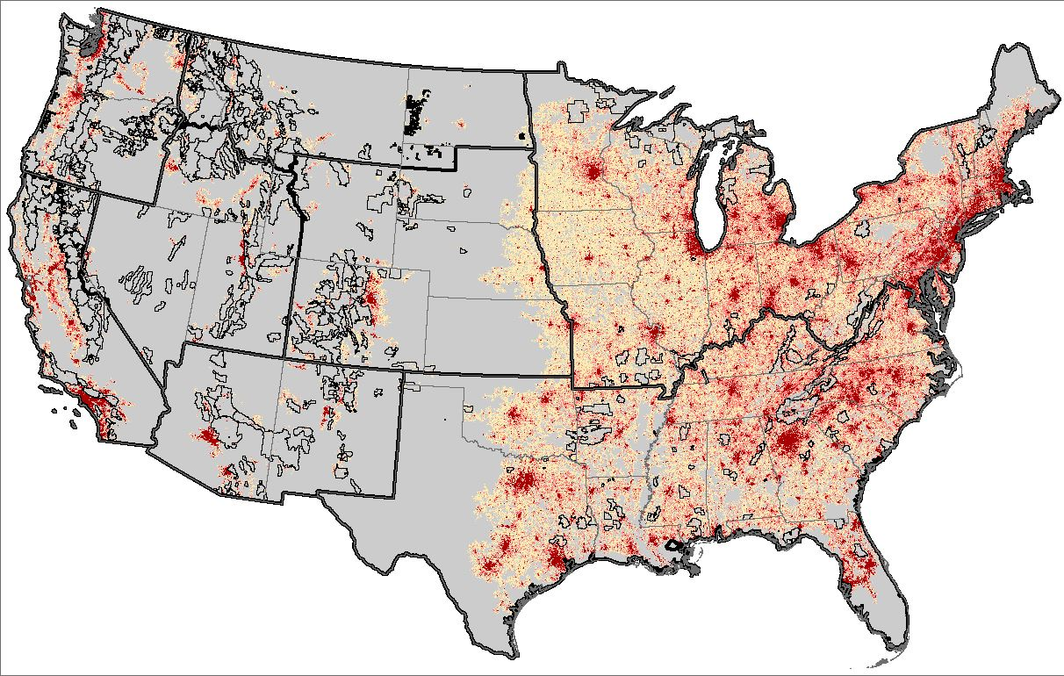

HVRA Characterization
Communities
  Residentially Developed Populated Areas (RDPA)
  Developed from LandScan USATM 2013 population distribution dataset (2010 Census)
Haas et al. 2013

Slide 17
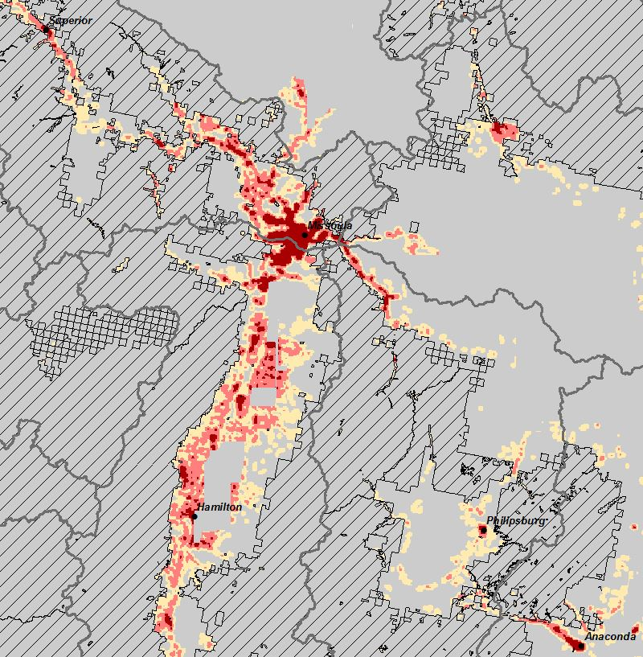
HVRA Characterization
Communities
  Residentially Developed Populated Areas (RDPA)
  Included within 5km of FS Ownership
  Excluded pixels on FS Ownership
Haas et al. 2013

Slide 18
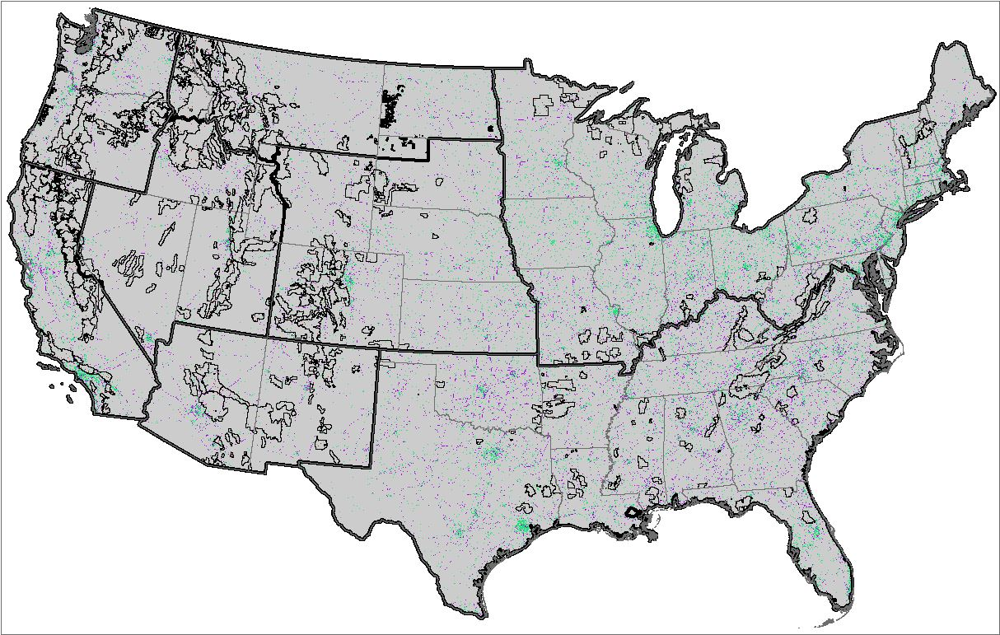
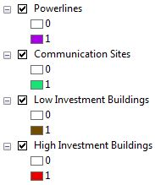
HVRA Characterization
Infrastructure
  Powerlines and Communications Sites
  USFS Buildings and Developed Recreation Sites
Notes:
Note that spatially these things just take up less area… they are point or line features and their influence on risk is generally fairly limited and spatially restricted

Slide 19
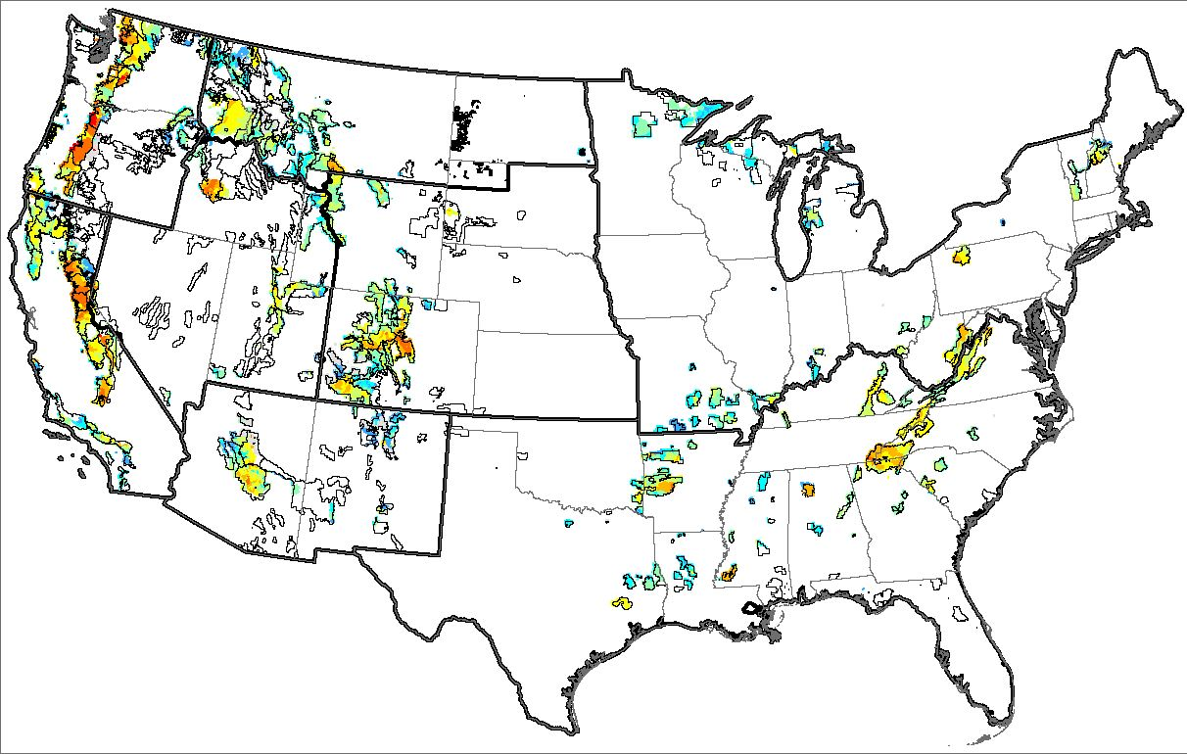

HVRA Characterization
Surface Drinking Water
  Derived from USFS Forests to Faucets dataset (Weidner and Todd 2012) overall index of surface drinking water importance by HUC12 sub-watersheds
  Adjusted by HUC8 sub-basins based on NFS contribution to critical drinking water supply
Notes:
We did a lot of work with the Forests to Faucets data… too much to go into here

Slide 20
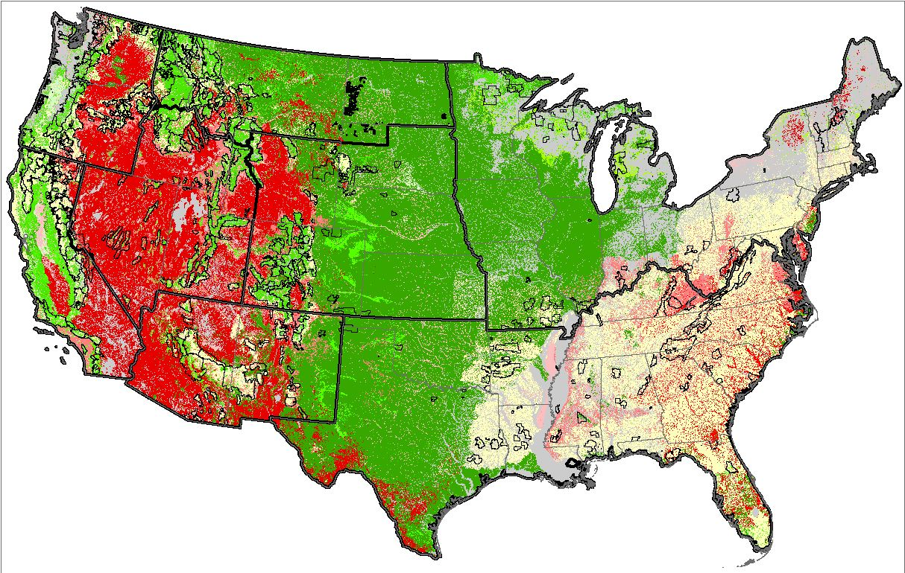
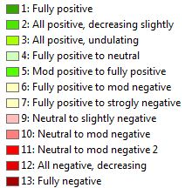
HVRA Characterization
Ecosystem Function
  Derived from LANDFIRE Biophysical Settings (BpS)
  Groupings based on ecological setting, historic fire frequency, and general fire ecology → 84 groups
  Assigned to 13 response functions

Slide 21
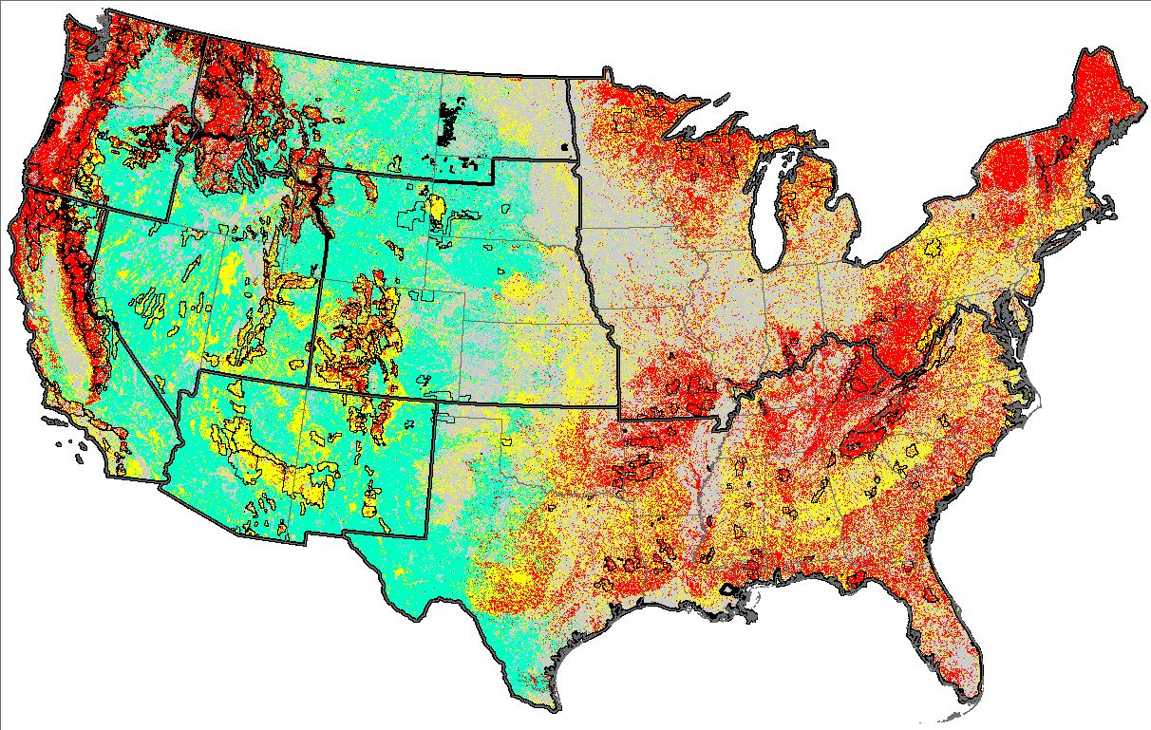

HVRA Characterization
Air Quality
  Potential PM 2.5 wildfire emissions
  Compiled from research efforts in PNW and RMRS to model emissions from LANDFIRE and FIA data

Slide 22
HVRA Characterization
Response Functions
  “Fire Sensitive” – Moderate to strong loss

Slide 23
HVRA Characterization
Response Functions
  “Fire Susceptible” – Neutral at low intensity, increasing loss at higher intensities

Slide 24
HVRA Characterization
Response Functions
  “Fire Adapted” – Benefit at some intensity

Slide 25
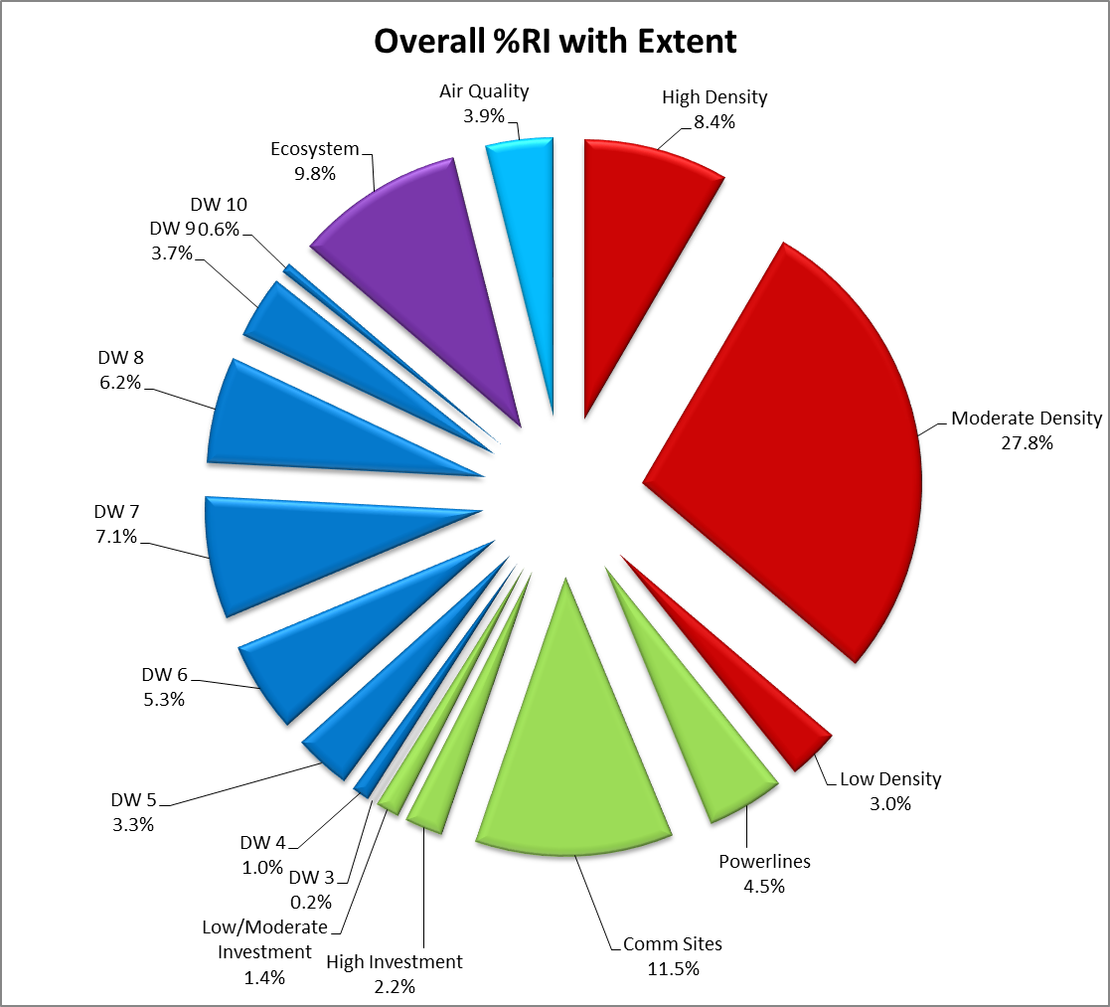
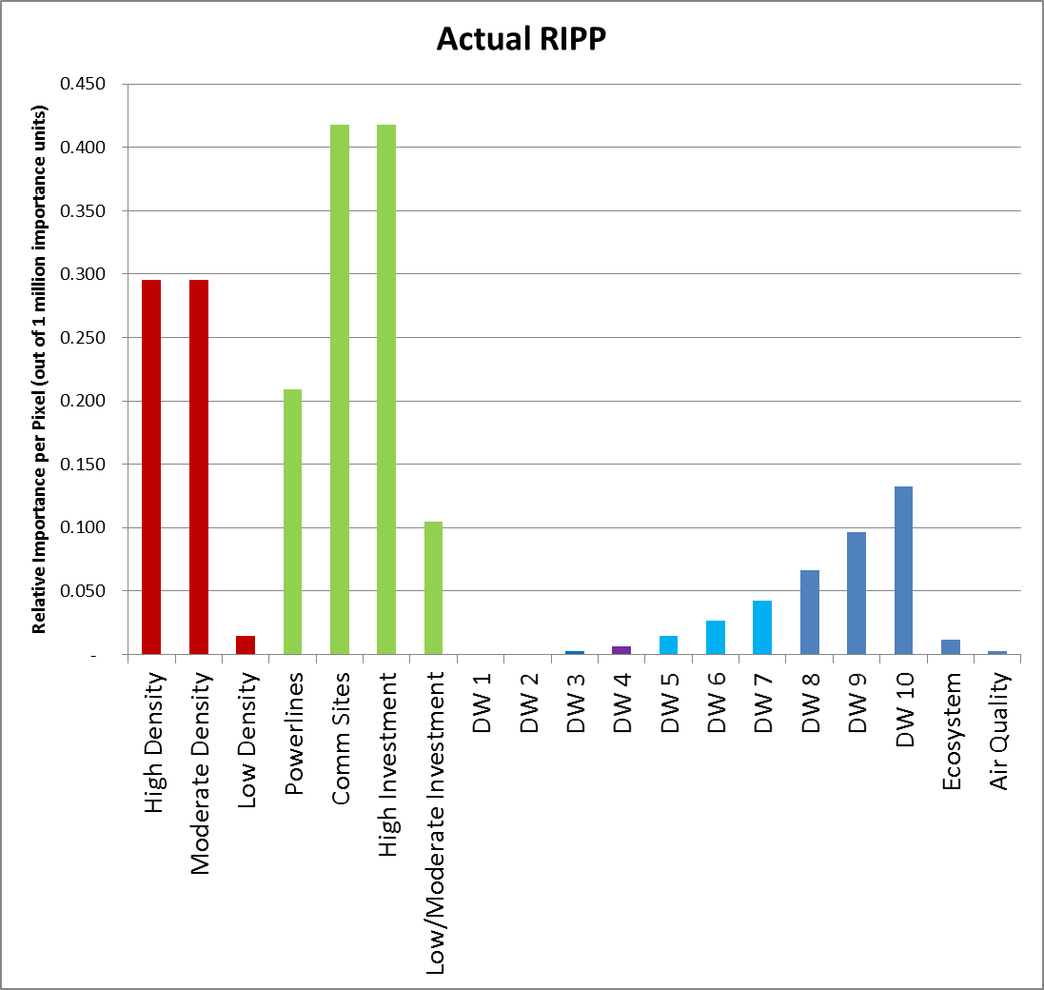
HVRA Characterization
Relative Importance
  Initially engaged SLMBOD in 2014 to prioritize the HVRAs
  Relative Importance and Relative Extent (pixel counts) work together to determine influence any HVRA has on NVC outputs
  Adjusted RI values through draft iterations

Slide 26
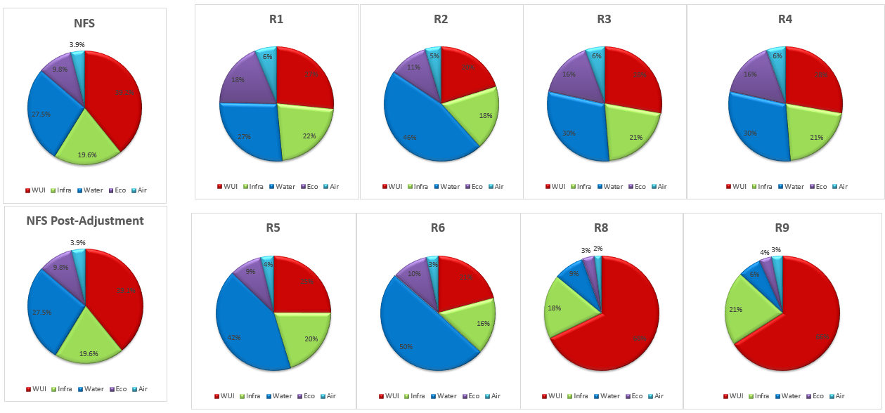
HVRA Characterization
Relative Importance
  Adjusted RI for Surface Drinking Water by NFS Region, based on contribution of NFS lands to regional drinking water supply
  Relative Extent of each HVRA varies in different NFS Regions
  As a result, the influence of specific HVRAs varies by Region

Slide 27
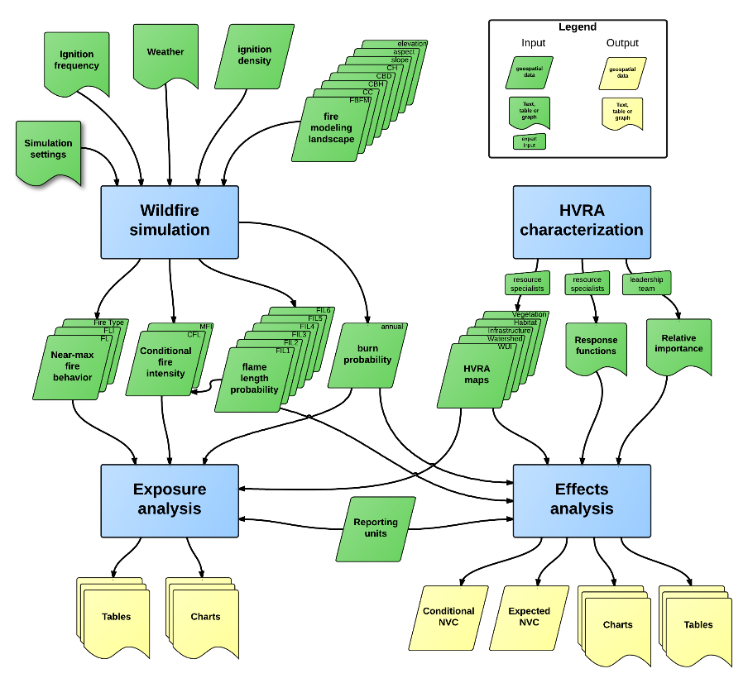
Results: Effects Analysis
Outputs
  Conditional Net Value Change (cNVC)
  Expected Net Value Change (eNVC)
  Expected Benefits
  Expected Losses
Maps
  Pixel-level outputs (270 meter pixels)
  Summarized by National Forest
Graphs and Tables
  Summarized by National Forest
  Summarized by NFS Region

Slide 28
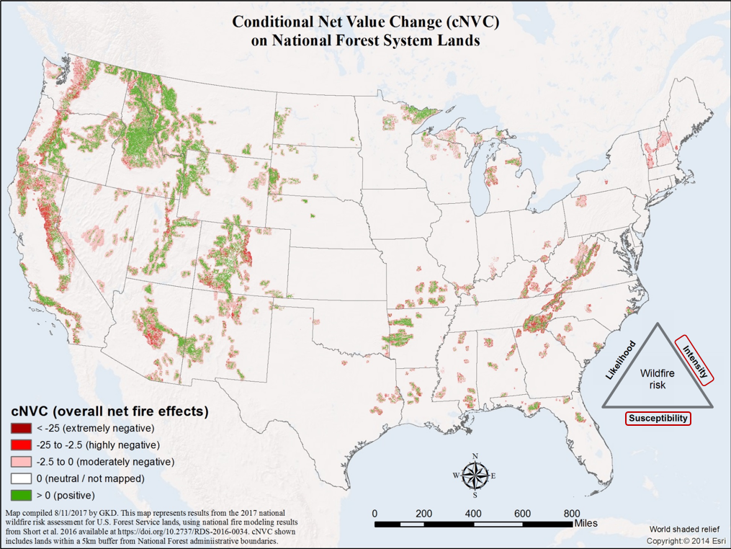

Slide 29
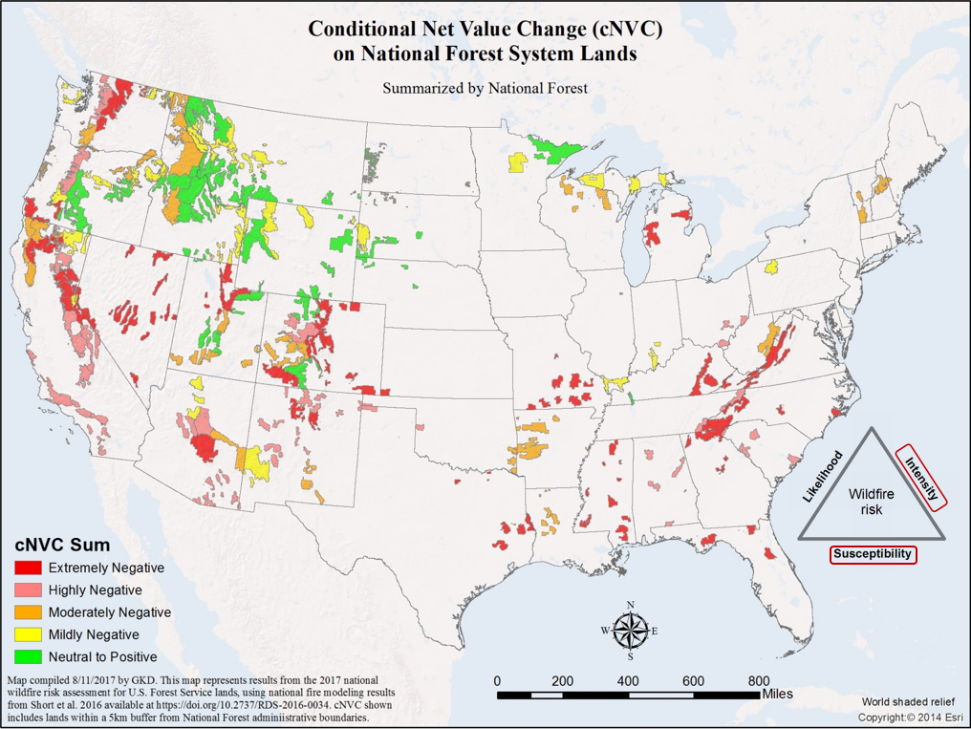

Slide 30
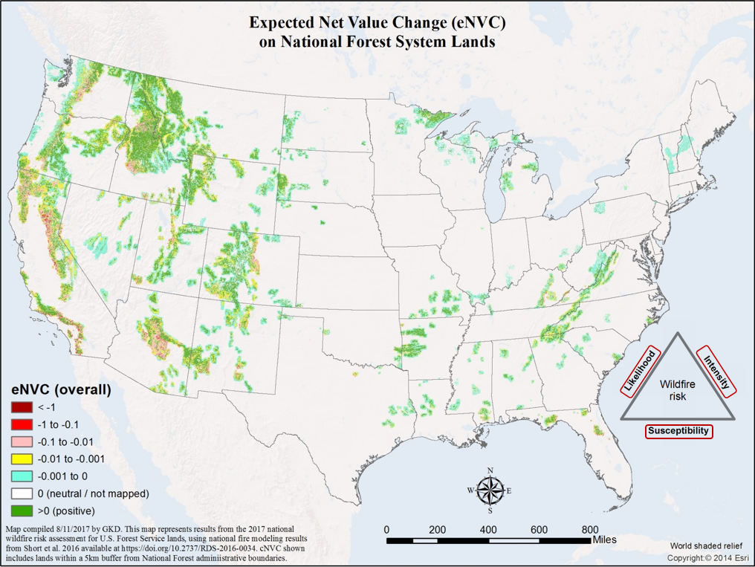

Slide 31
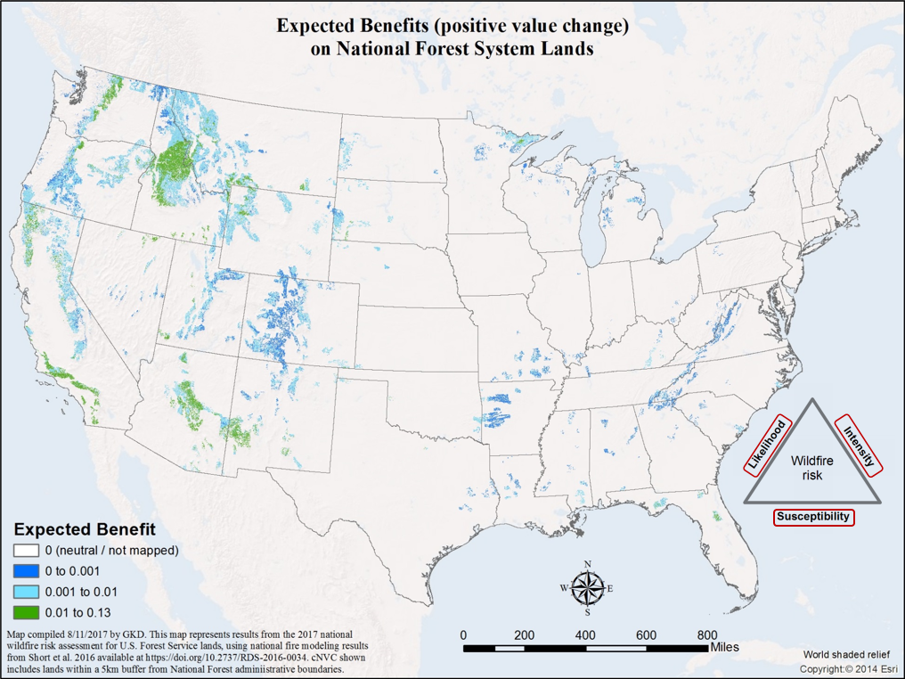

Slide 32
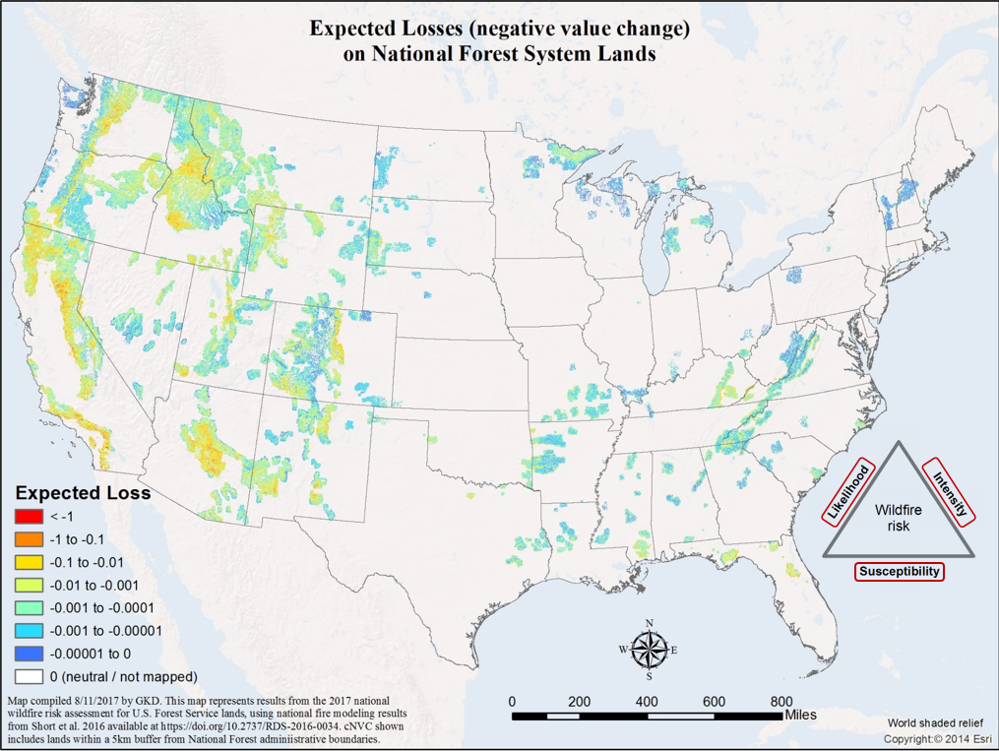

Slide 33
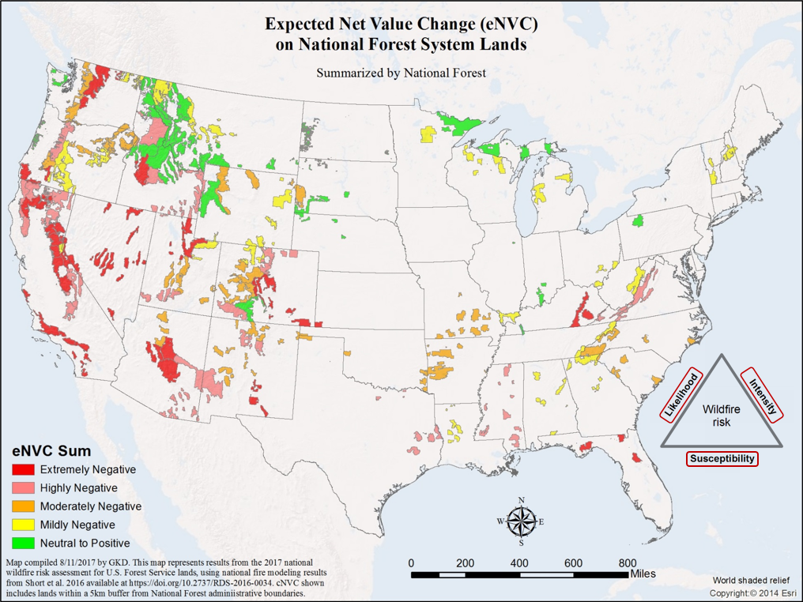

Slide 34
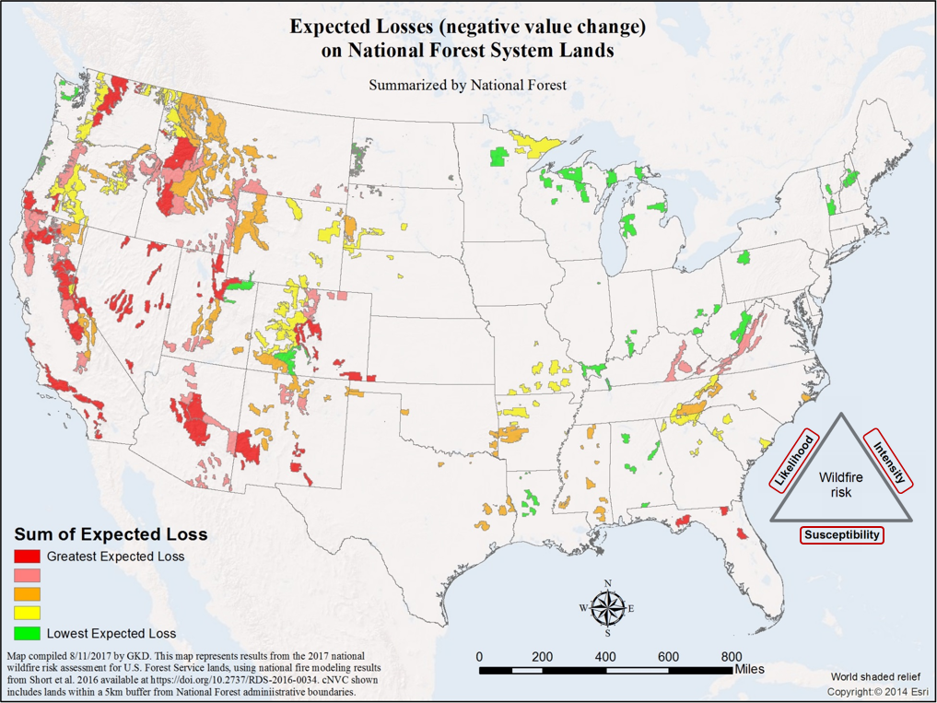

Slide 35
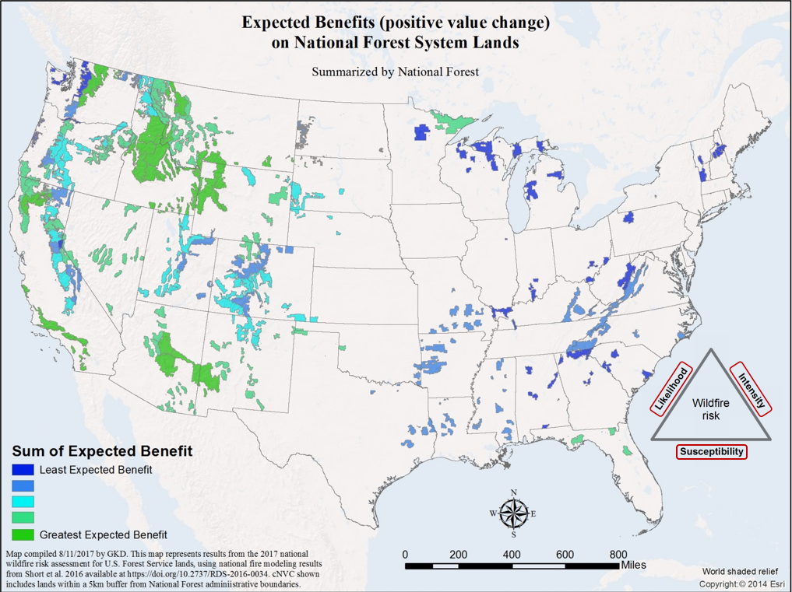

Slide 36
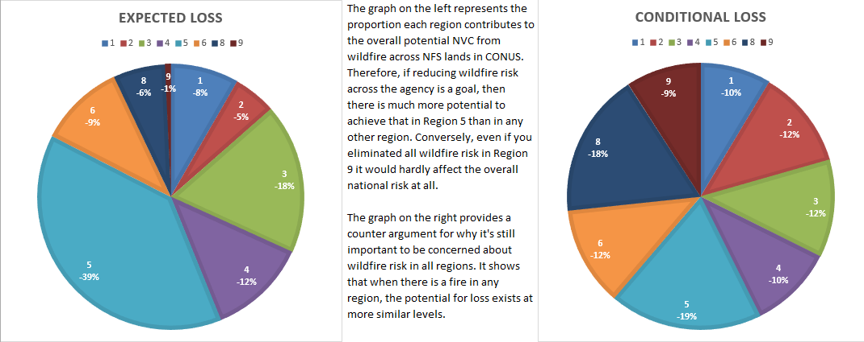
Conditional vs. Expected

Slide 37
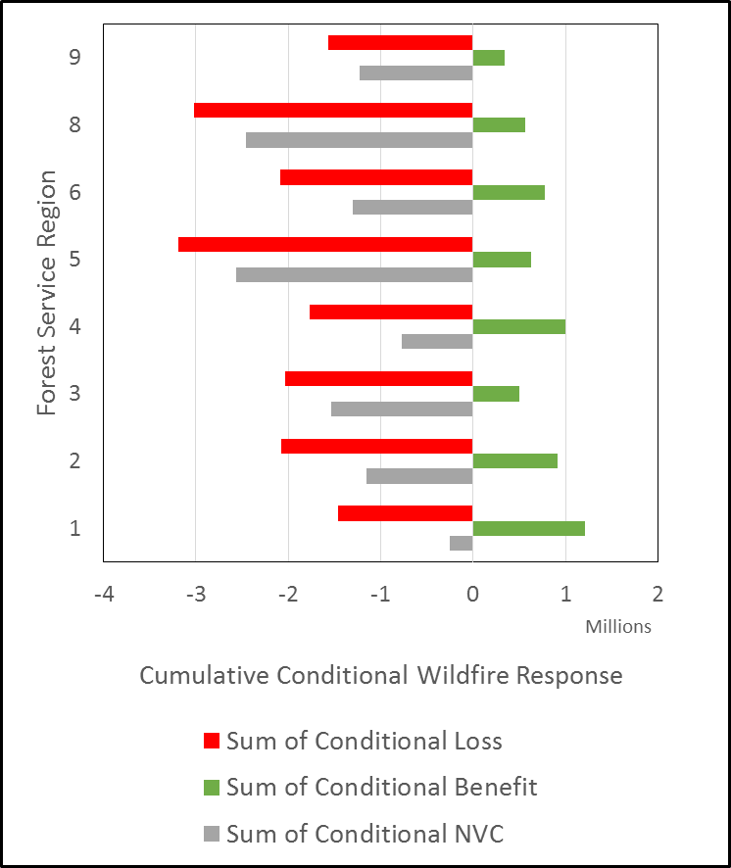
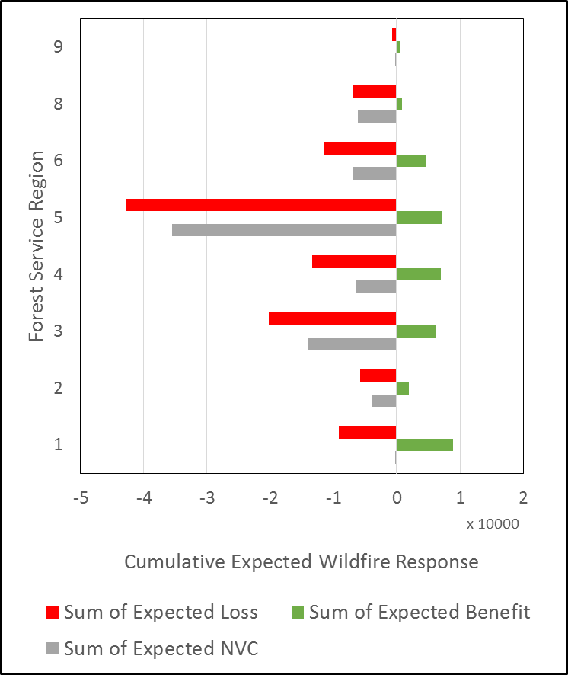
Conditional vs. Expected
Notes:
Conditional is useful for response planning
Expected is most useful for about everything else, particularly resource allocation
Red bar, Green bar, Gray bar. Our index focuses on the red bars. The index for each region individually (and all regions combined) would be set to 100 as the baseline. The relative size of the red bars is different; it reflects the share of overall “risk” held by each region.

Slide 38
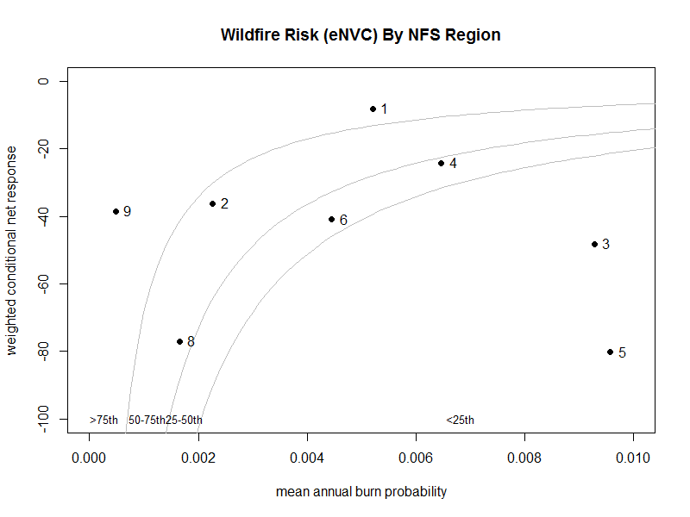
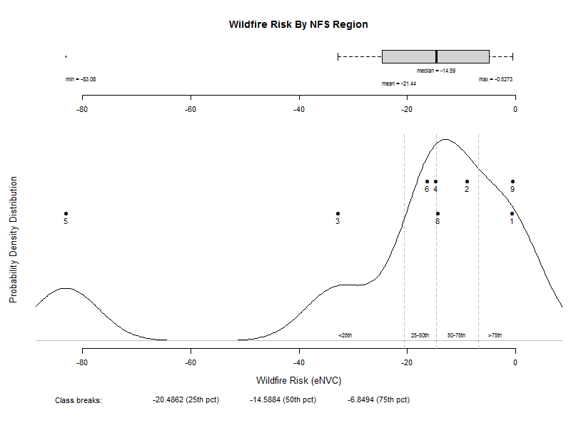
Conditional vs. Expected
Notes:
Conditional is useful for response planning
Expected is most useful for about everything else, particularly resource allocation
Red bar, Green bar, Gray bar. Our index focuses on the red bars. The index for each region individually (and all regions combined) would be set to 100 as the baseline. The relative size of the red bars is different; it reflects the share of overall “risk” held by each region.

Slide 39
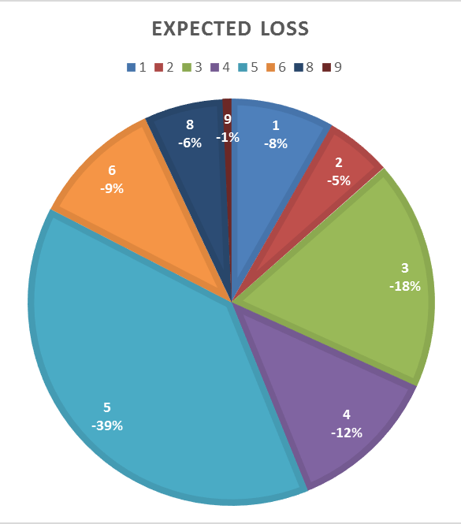
Risk Index
Choosing to focus the index on the expected losses (red bars)
  Most closely reflects the Strategic Plan objective to “mitigate” wildfire risk
  Pie chart captures the relative size of the red bars as the share of expected losses in each region
  Goal is to reduce overall risk by mitigating potential losses (i.e., moving from lower right to upper left on scatter plot)

Slide 40
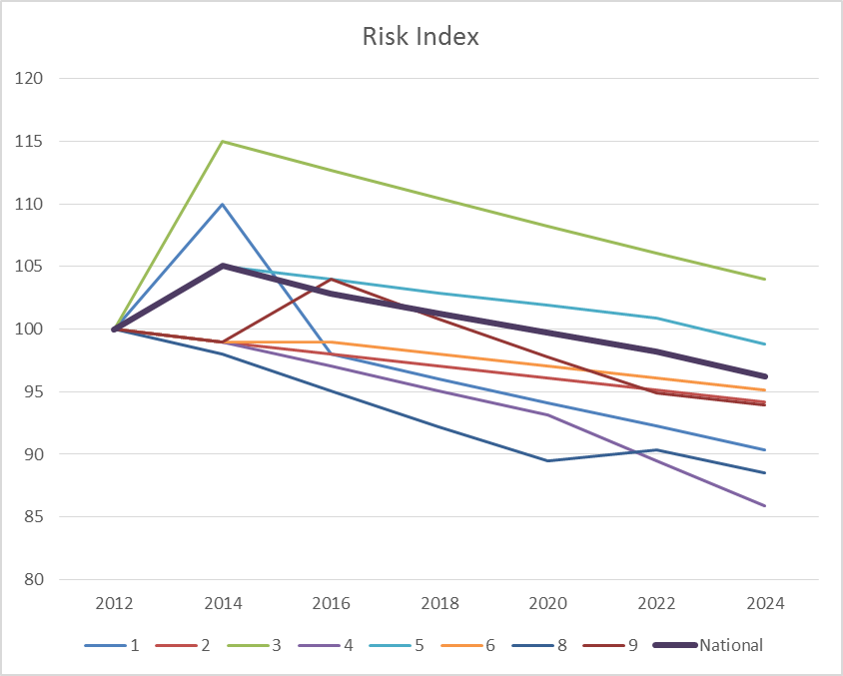
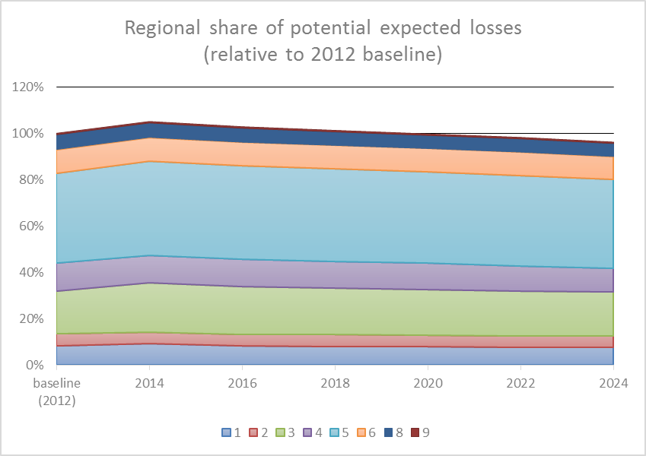
Risk Index
“The baseline value, at least for economic indcators, is usually 100.” – Economic Indicators for Dummies, Michael Griffis, 2011
Baseline Risk
  We set the baseline value equal to 100
  This value represents the most recent conditions available (2012)
  Graphs of how the index could change over time might look like this:
Notes:
There is a long standing practice in economics of using 100 as a baseline value and then tracking changes over time.
The graph on the left depicts how the index could vary independently by region (colored lines) and for all CONUS NFS land combined (thicker black line).
The graph on the right depicts the same information from the pie chart on the previous page, stretched out into the future with hypothetical numbers. The top of this chart corresponds to the CONUS NFS line in the left chart.

Slide 41
Remaining Work
Deliver information about the assessment online
  Post documentation and results
  Post data, develop Story Map(s), etc. for users to explore the data interactively
Test sensitivity to landscape changes
  National scope: calculate NVC and risk index for 2014 landscape conditions
  Use CFLRP landscapes to test multiple points in time (pre-treatment, 2012, 2014, and hypothetical 2019 post-treatment)
  Estimate the potential for agency actions to mitigate wildfire risk in different landscapes
Develop a process for annual or bi-annual updates
  New vegetation and fuels data become available every two years
  Can we capture annual changes? Can we update data to current conditions?
Expand the analysis to all lands
  Most data sources already cover all lands
  Will need to make some adjustments to Relative Importance outside of NFS land
Notes:
How sensitive is the data to changes? Management actions? Wildfires? Increase in WUI? What would it take to change the response function?
We can track the changes every two years as new veg and fuels data become available. Are there ways to show annual changes? Can we update the data to “current” conditions or will we always be 3 to 5 years behind? How do we represent the value of maintenance treatments that don’t reduce risk, but maintain a desired condition?
There is a lot of interest in an all-lands map that depicts relative risk across ownerships.
The index may be useful for other land managers at different summary units like state, BLM district, regional groups of states, etc.
Our ability to change risk at a site-specific location or across a landscape is not equal. Some ecosystems respond better to treatments.

Slide 42
Questions?

