Slide 1
Results and Application of the National Risk Assessment
Greg Dillon
USDA Forest Service, Rocky Mountain Research Station, Fire Modeling Institute
Missoula, Montana
The Fire Continuum Conference
Preparing for the Future of Wildland Fire
Missoula, Montana USA
May 22, 2018

Slide 2
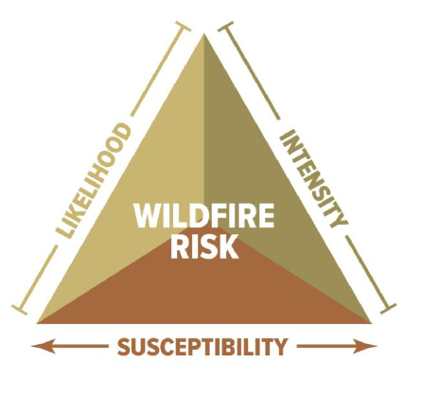
What is a Wildfire Risk Assessment?
Wildfire Risk: A measure of the probability and consequences of uncertain future wildfire events.
Notes:
Main intention with this slide is to introduce the three components of risk: likelihood, intensity, and susceptibility. Risk is a measure of the probability AND consequences of uncertain future wildfire events.
To talk about consequences (i.e., susceptibility), we have to have information about something of value on the landscape (HVRAs). For community assessments, the community itself is the HVRA. The most direct way to map that is by using structure density or population density.
I also want to just introduce/define the terms “hazard” and “exposure” here because those are important concepts in talking about risk, particularly for communities.

Slide 3
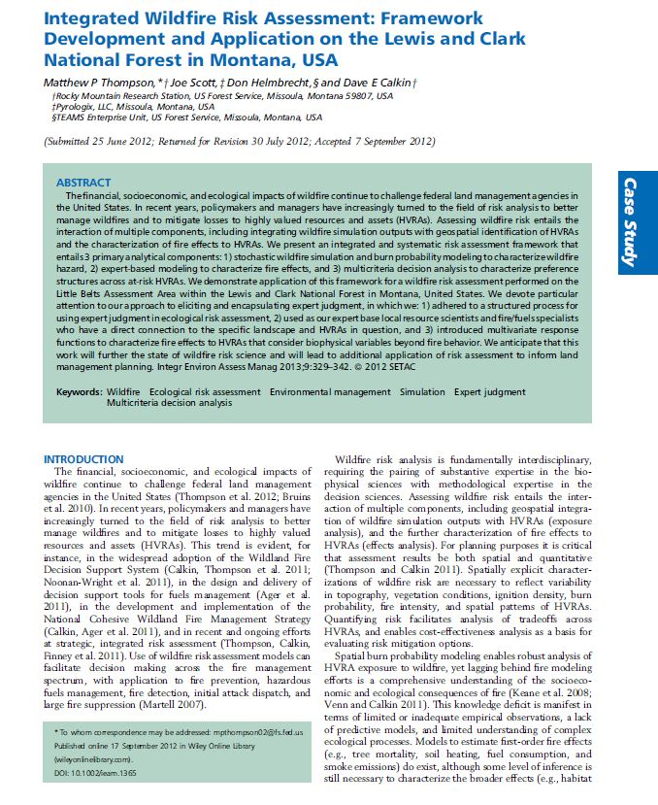
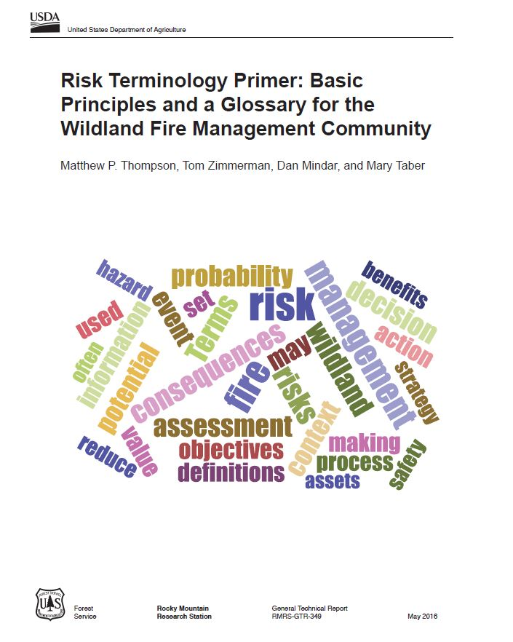
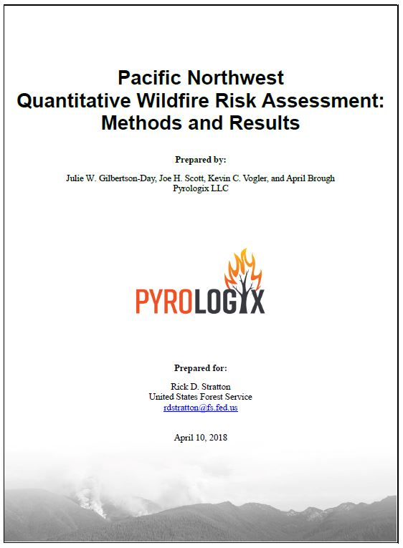
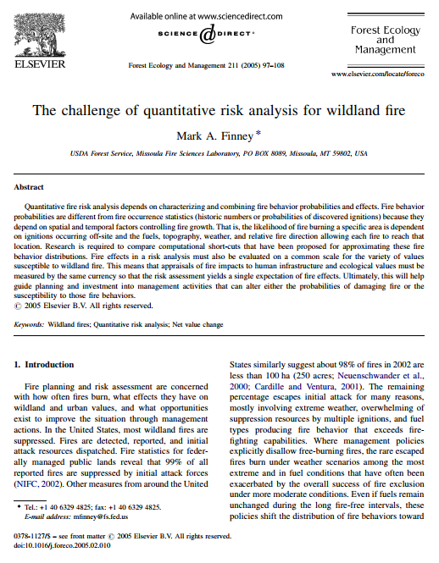
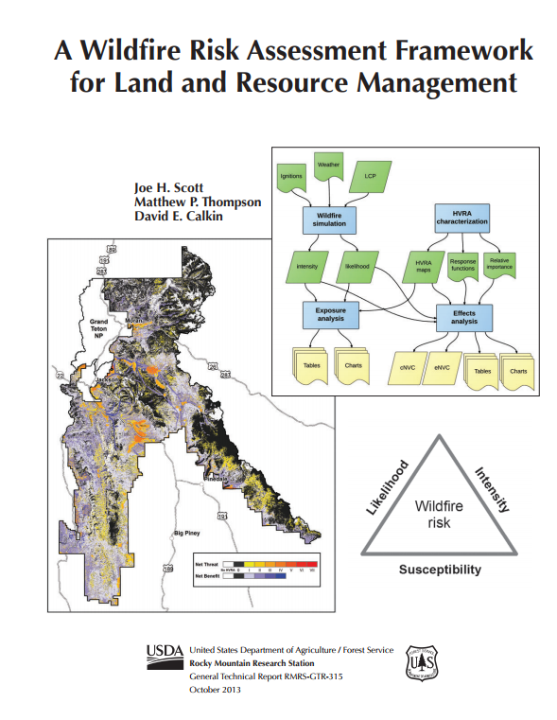
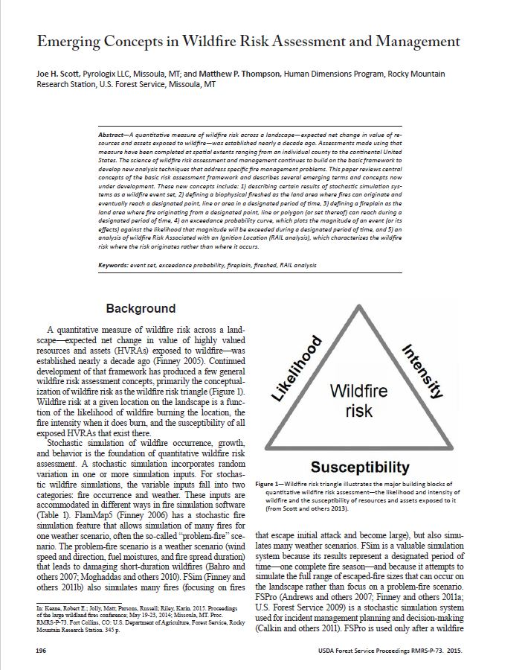
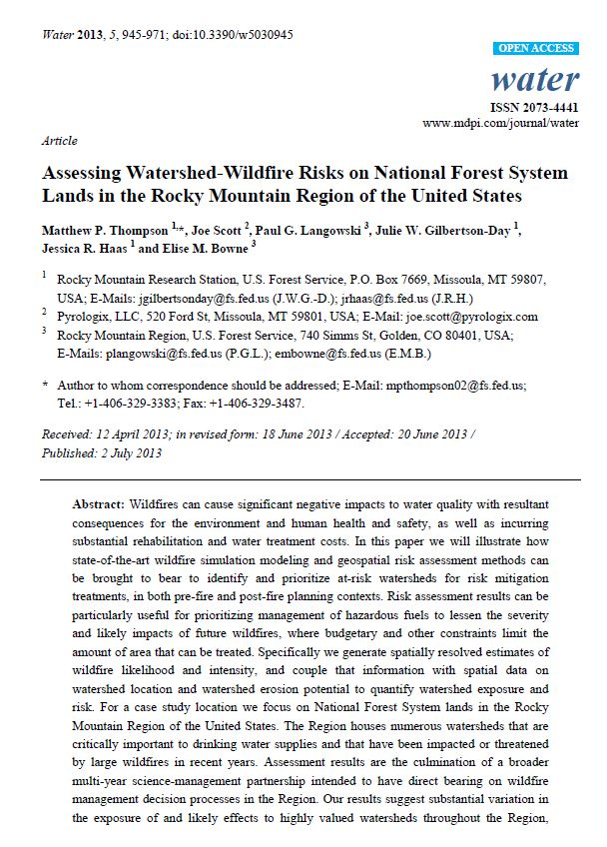
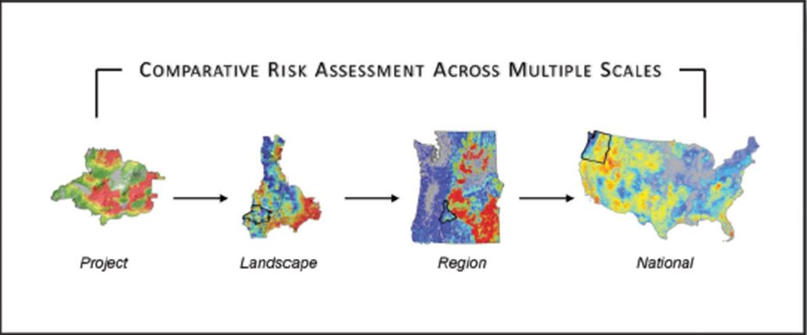
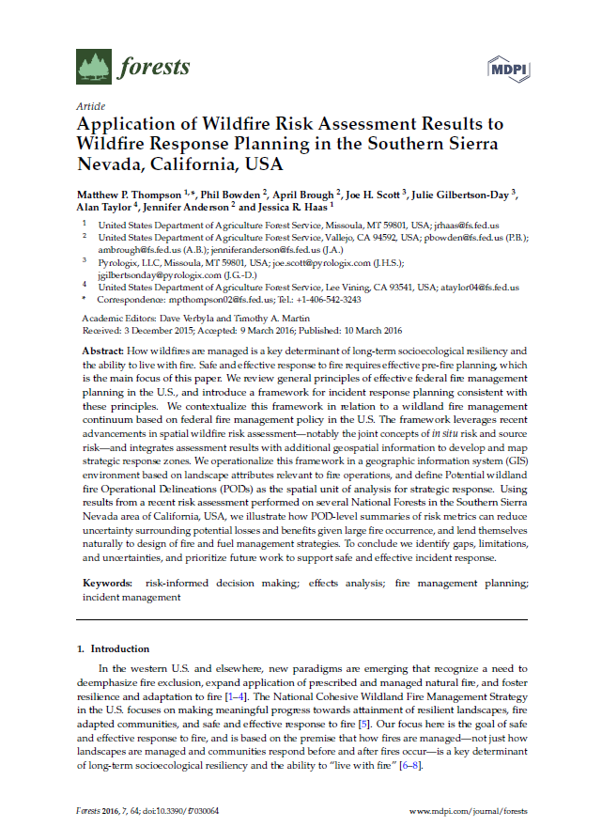
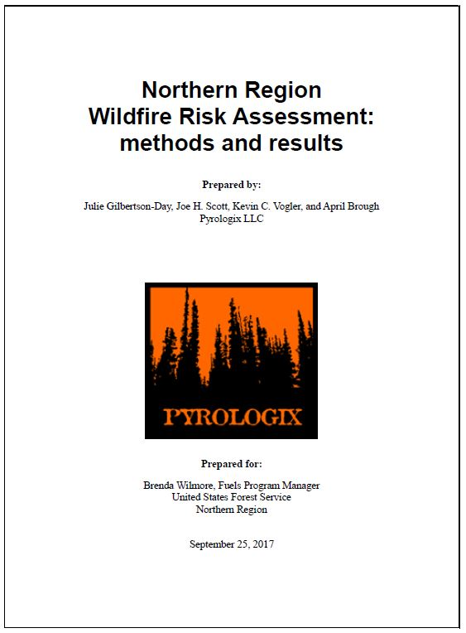
Notes:
This slide starts with three foundational wildfire risk science documents….
Finney’s 2005 paper that formulated the quantitative risk equation. It took the basic equation for calculating risk from other disciplines and put it in terms of wildfire language and variables.
The Cohesive Strategy Science Report. important because it explains the adoption of wildfire risk science as the basis for management of wildfire risk across land ownership boundaries, and demonstrates the scalability of the framework. The methodology is consistent at local/project scales as well as national scale.
USFS RMRS_GTR-315… put methods into a framework that has become the foundation for risk assessments that have followed
Many studies at lots of different scales have followed, and there are more all the time.
These studies demonstrate the scalability of the risk assessment framework… it works from local project up through to the national scale.
BUT… there are tradeoffs at different scales (spatial resolution, level of thematic detail in HVRAs, spatial consistency) → these mean that assessments at different scales inherently inform different questions
SO… why do one at a national scale when we have all these local and regional assessments??

Slide 4
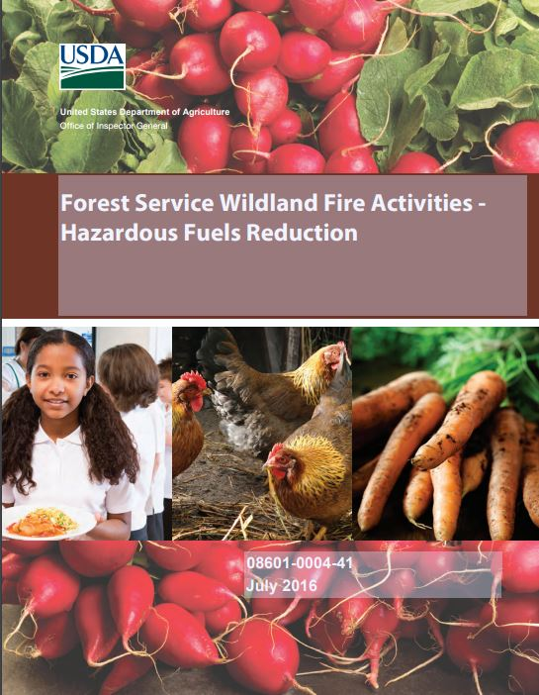
Why a National Risk Assessment?
Recommendation 1:
Fully develop and implement a national risk assessment model for identifying and prioritizing hazardous fuels reduction projects on National Forest System lands.
Agency Response:
… The national office is developing a national risk model that will be used to identify and prioritize hazardous fuels reduction areas. The results will inform allocation of resources to the regional level. Projects will be designed based on those priority areas; however the priority of implementation of individual projects is not a national-scale decision.
July 2016 USDA OIG Report
Notes:
OMB, OIG, and others want to know what they’re getting for their investments in a hazardous fuels program. The FS needs a consistent and credible tool for talking about fuels management priorities and accomplishments at a national scale.
Risk assessment can inform budget and resource allocation decisions… but only one piece of information
Risk assessment helps to align national policy and management direction with cohesive strategy goals:
Restore and maintain resilient landscapes
Create fire-adapted communities
Improve safe and effective fire response\
Risk assessment provide a scientifically-based and spatially-specific communication tool to convey
Potential risks and benefits of wildfire on NFS lands
Fuels management priorities from a national perspective

Slide 5
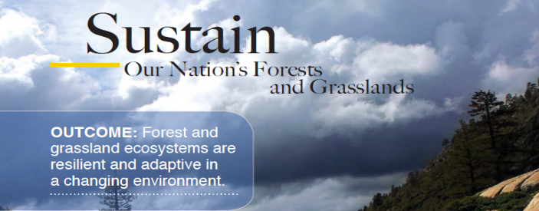
Why a National Risk Assessment?
Strategic Objective B:
Mitigate Wildfire Risk.
Fire and Aviation Management Briefing Paper, December 2016:
…FAM has developed a wildfire risk index based on the Probability and Intensity of wildfire and the Exposure and Susceptibility of Highly Valued Resources and Assets (HVRA). The index is based on national-scale datasets.
… The Risk Index will track changes over time based on a statistically sound and repeatable process.
Notes:
OMB, OIG, and others want to know what they’re getting for their investments in a hazardous fuels program. The FS needs a consistent and credible tool for talking about fuels management priorities and accomplishments at a national scale.
Risk assessment can inform budget and resource allocation decisions… but only one piece of information
Risk assessment helps to align national policy and management direction with cohesive strategy goals:
Restore and maintain resilient landscapes
Create fire-adapted communities
Improve safe and effective fire response\
Risk assessment provide a scientifically-based and spatially-specific communication tool to convey
Potential risks and benefits of wildfire on NFS lands
Fuels management priorities from a national perspective

Slide 6
National-Scale Methods
Applied methods outlined in RMRS-GTR-315

Slide 7
National-Scale Methods
Applied methods outlined in RMRS-GTR-315
Leveraged national FSim modeling outputs

Slide 8
National-Scale Methods
Applied methods outlined in RMRS-GTR-315
Leveraged national FSim modeling outputs
Five primary Highly Valued Resources and Assets (HVRAs)
Communities
Infrastructure
Surface Drinking Water
Ecosystem Function
Air Quality

Slide 9
National-Scale Methods
Applied methods outlined in RMRS-GTR-315
Leveraged national FSim modeling outputs
Five primary Highly Valued Resources and Assets (HVRAs)
Calculated Effects Analysis outputs (cNVC, eNVC, +, -)
Communities
Infrastructure
Surface Drinking Water
Ecosystem Function
Air Quality

Slide 10
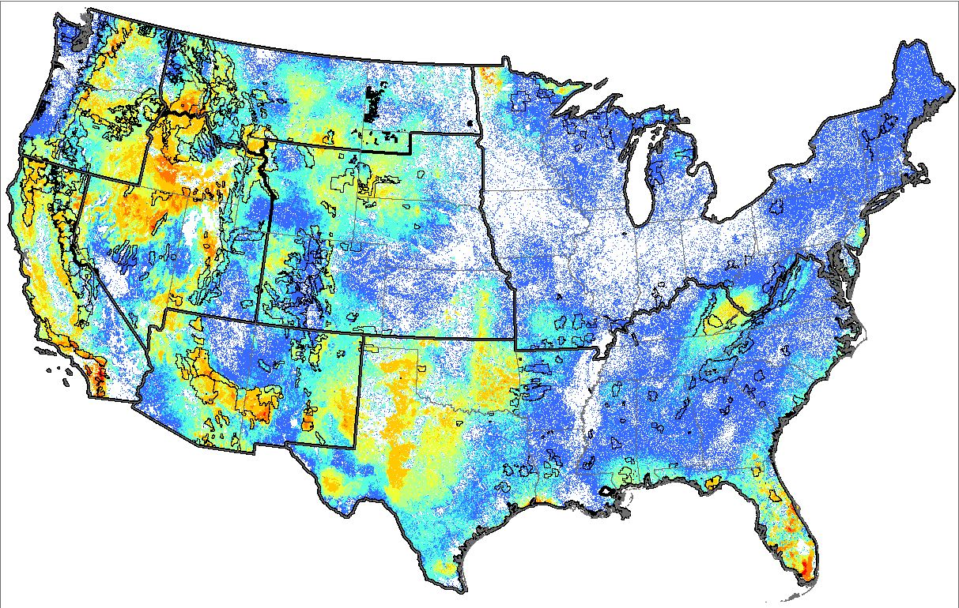
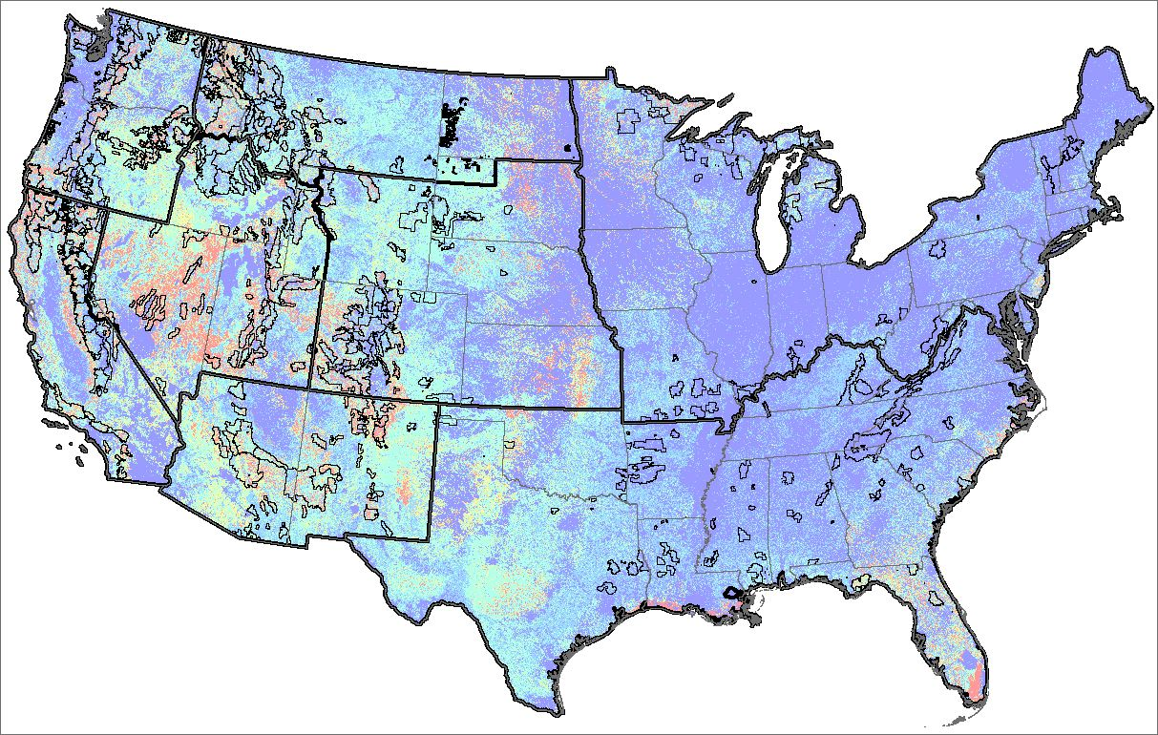
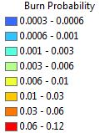
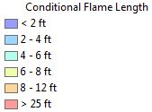
National Scale FSim Model Outputs
Modeling completed in 2016, uses LANDFIRE 2012 data
Likelihood
Intensity
Short and others. 2016. Spatial dataset of probabilistic wildfire risk components for the conterminous United States. Forest Service Research Data Archive. https://doi.org/10.2737/RDS-2016-0034
Short, Karen C. 2017. Spatial wildfire occurrence data for the United States, 1992-2015 [FPA_FOD_20170508]. 4th Edition. Forest Service Research Data Archive. https://doi.org/10.2737/RDS-2013-0009.4
Notes:
National FSim modeling:
Currently available online. Can serve as a good starting point for any local jurisdiction that doesn’t have the means to do their own fire modeling work.
Coarse scale… 270-m pixels
Latest released version is based on 2012 landscape conditions… 2014 is in progress
I can mention here that I’m doing a risk assessment at this full scale… currently just for the US Forest Service to help with prioritization and monitoring of fuels treatment work within the agency, but datasets cover all lands and one goal is an all-lands assessment.

Slide 11
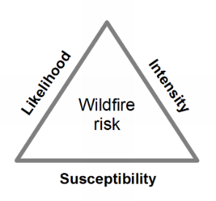
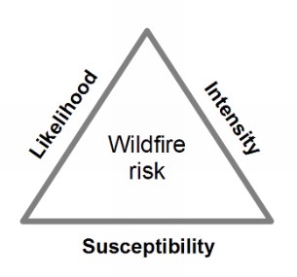
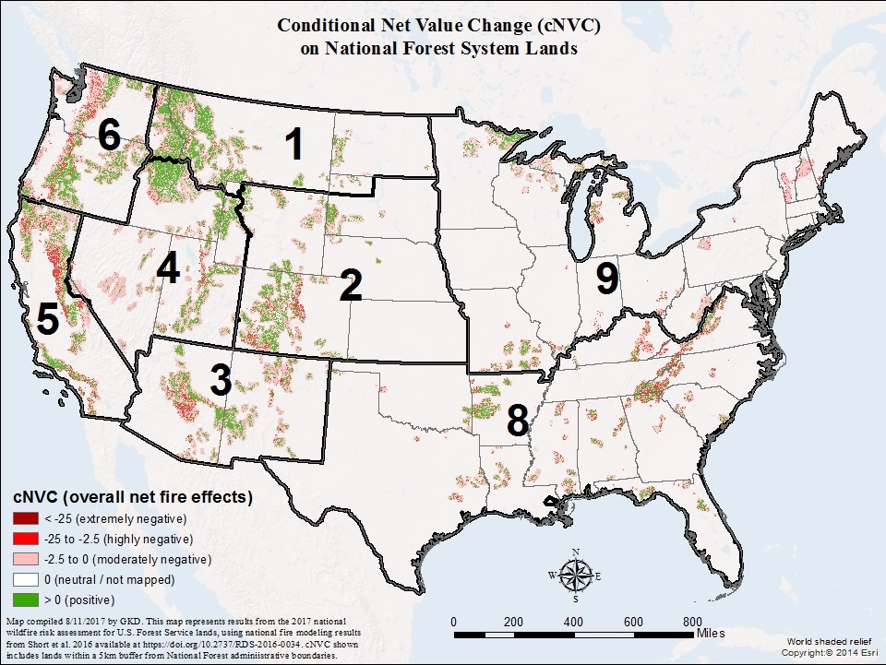
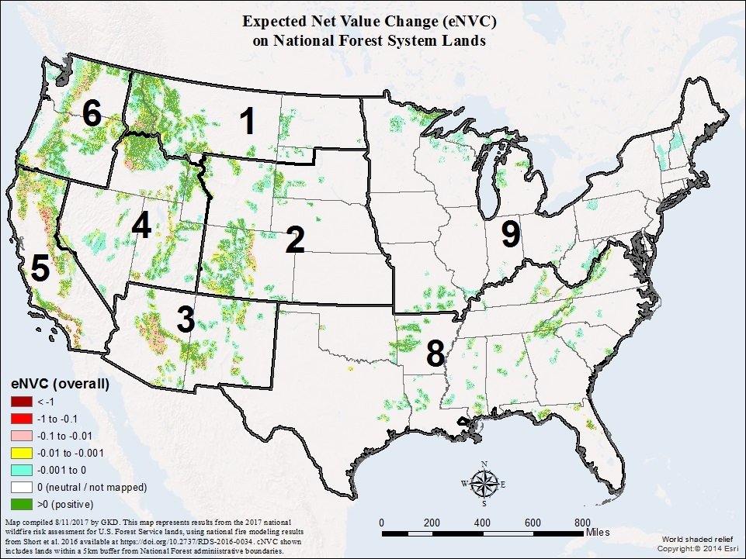
National Assessment Results
Notes:
Conditional is useful for response planning. It does not include the probability of fire occurrence… it just looks at what the potential consequences of fire would be if one were to occur.
Expected is most useful for about everything else, particularly resource allocation. It does include probability of occurrence, and is therefore a full measure of risk.
From the maps we can see some interesting patters at this scale, but much of the heterogeneity gets washed out at this scale. One pattern that emerges at this wide view is that where we have large contiguous areas of NF in the fire-adapted ecosystems of the west, the net effect of fire is often positive.
There are many fairly subtle patterns that you have to zoom in closer to see. I hope to create a web-based story map so anyone can do that.

Slide 12
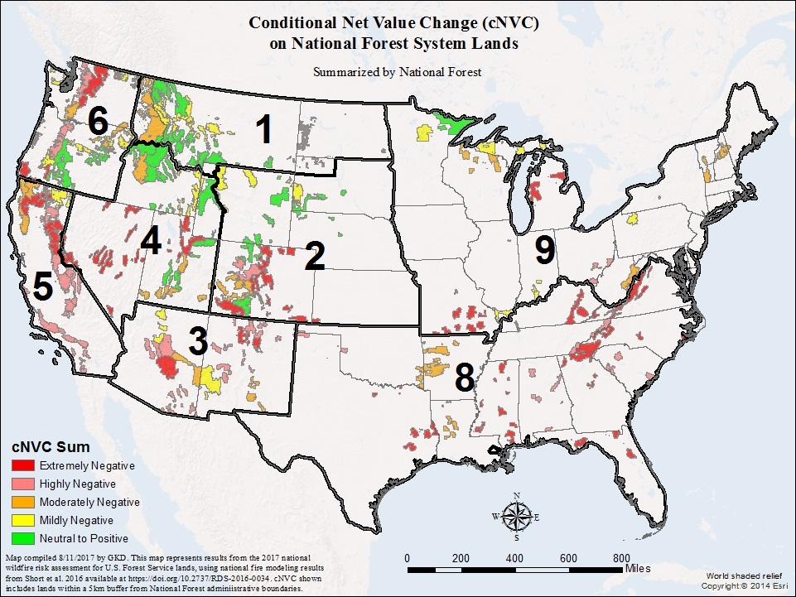
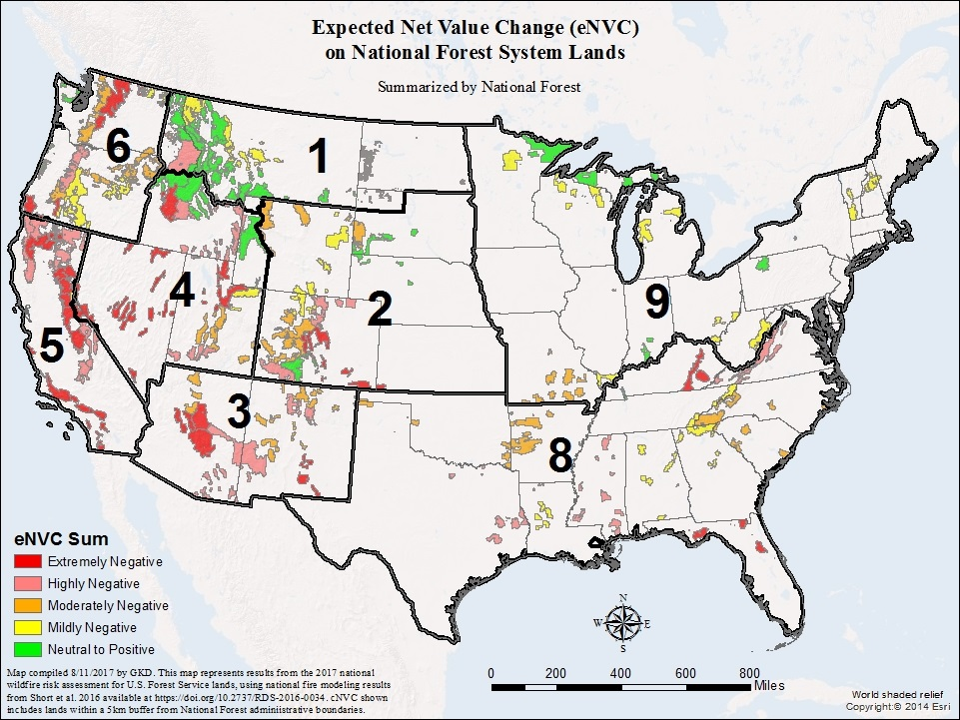
National Assessment Results
Notes:
One thing we can do is summarize the pixel values up to individual National Forest units. Here, we are looking at the SUM of all cNVC and eNVC pixel values across each National Forest. They are categorized into five even quantiles here for display.
We can also summarize the data by the larger NFS regions. From a budget and resource allocation perspective, this is really where the FS FAM program really needs to understand the relative differences. From the national perspective, they allocate resources to the regions and let the regions and individual forests decide (mostly) how to prioritize those resources.
Really the whole point of the national assessment is to have consistent numbers across the regions.

Slide 13
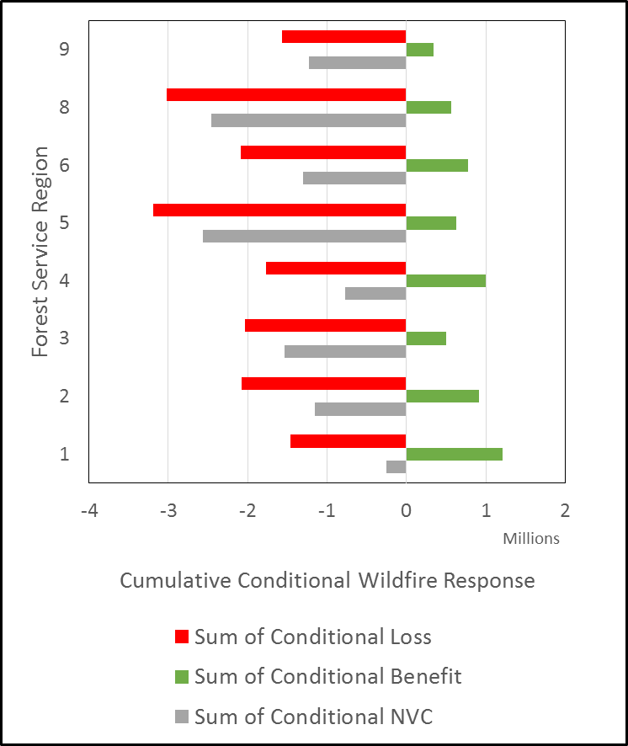
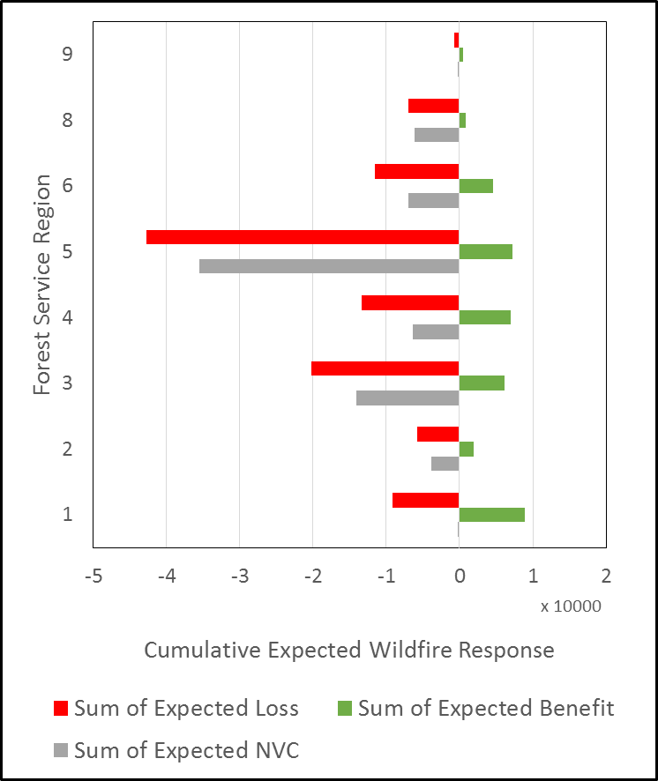
National Assessment Results
Notes:
These bar charts show the sum of cNVC (left) and eNVC (right). They also break NVC down into it’s component parts of benefit and loss.
Red bars show the losses
Green bars show the benefits
Gray bars show the net (i.e., NVC)
For the purposes of creating a national risk index, we chose to use the expected losses (red bars on the right)…

Slide 14
Results and Application
Risk Index: we chose expected losses
Why use losses and not eNVC?
eNVC gets “cancelled out” in some regions
FS Strategic Plan objective is to “mitigate wildfire risk”… using losses focuses on what the agency can possibly mitigate
Benefits in this assessment are an inherent ecosystem property and can’t be changed by management actions
Why use expected and not conditional?
Notes:
For the purposes of creating a national risk index, we chose to use the expected losses (red bars on the right)…

Slide 15
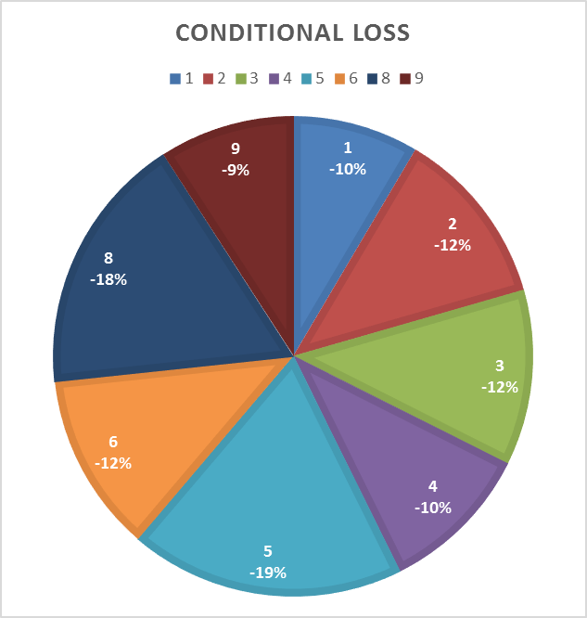
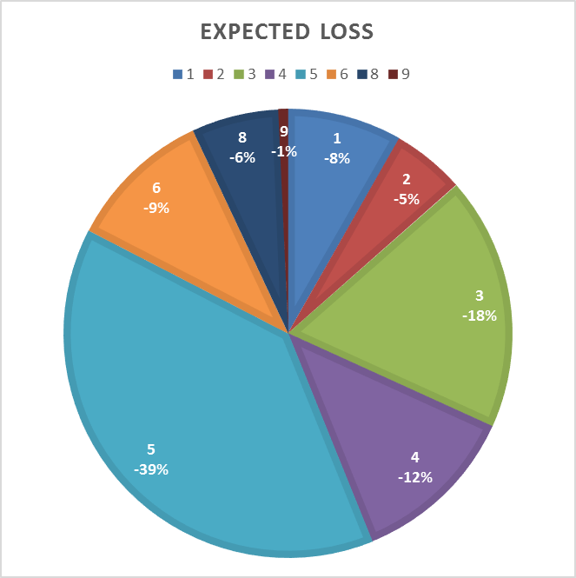
Conditional Loss
When a fire occurs, the potential for loss exists at somewhat similar levels in all regions.
Expected Loss →
This shows the proportion each region contributes to the overall potential for loss across NFS lands.
It includes the probability of fire occurrence.

Slide 16
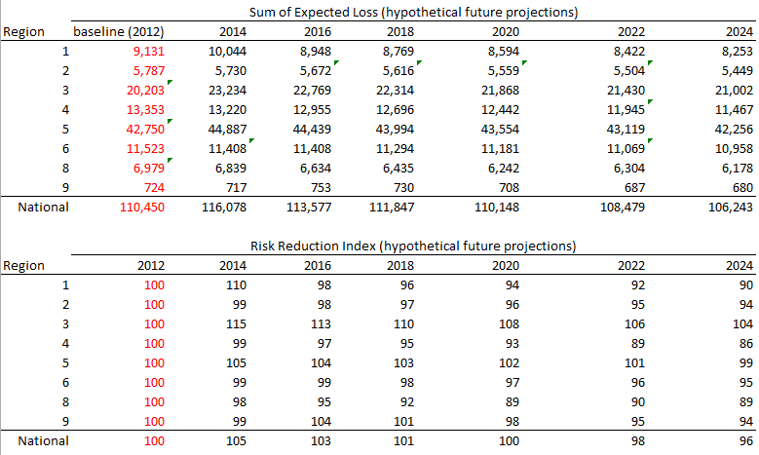
Results and Application
Expected loss numbers from this assessment represent a baseline
“The baseline value, at least for economic indcators, is usually 100.”
Economic Indicators for Dummies, Michael Griffis, 2011
Notes:
There is a long standing practice in economics of using 100 as a baseline value and then tracking changes over time.
The index for each region individually (and all regions combined) would be set to 100 as the baseline.

Slide 17
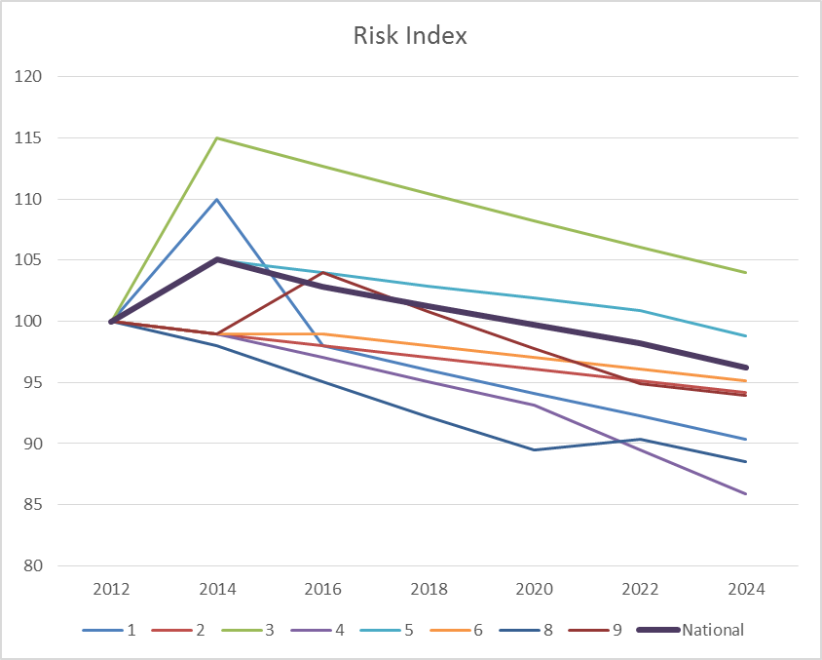
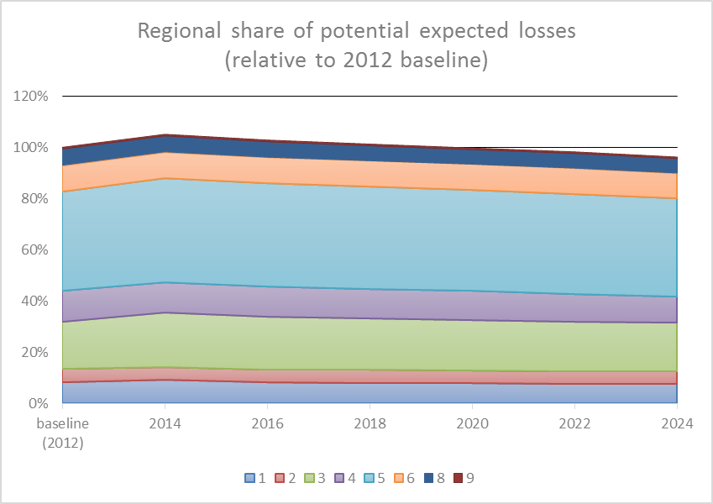
Results and Application
Expected loss numbers from this assessment represent a baseline
Notes:
These graphs show the hypothetical future calculations from the table on the previous slide.
The graph on the left depicts how the index could vary independently by region (colored lines) and for all CONUS NFS land combined (thicker black line).
The graph on the right depicts the same information from the pie chart of expected losses, stretched out into the future with hypothetical numbers. The top of this chart corresponds to the CONUS NFS line in the left chart.

Slide 18
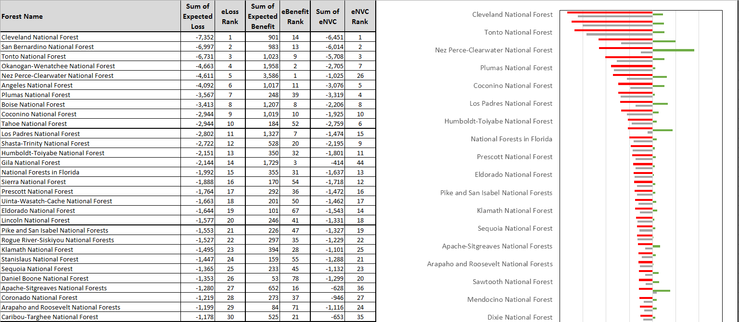
Results and Application
Focus of this assessment is on regional and national results
But, we can also look at the Forest-level summaries…
Notes:
For the most part, these forest-level summaries won’t be used to make programmatic resource allocation decisions.
One exception is that these rankings are being used to inform the selection of projects for supplemental fuels treatment funding. Guidelines sent out this year identified usually the top three forests in each region (in terms of the expected loss rank, as well as other forests in the region generally within the top 30 nationally. Using this approach recognized that regions like the Pacific Southwest (R5) have many more forests in the top 30 and would reasonably have a greater need to fund specific projects with supplemental funding.

Slide 19
Remaining Work…
Deliver information about the assessment online
Post data, documentation, develop Story Map for interactive data exploration
Test sensitivity to landscape changes
National scope: calculate NVC and risk index for 2014 landscape conditions
Use CFLRP landscapes to test multiple points in time (pre-treatment, 2012, 2014, and hypothetical 2019 post-treatment)
Estimate the potential to mitigate future wildfire risk in different landscapes
From treatments? From wildfires?
Develop a process for annual or bi-annual updates
Expand the analysis to all lands
Most data sources already cover all lands
Will need to make some adjustments outside of NFS land
Notes:
How sensitive is the data to changes? Management actions? Wildfires? Increase in WUI? What would it take to change the response function?
We can track the changes every two years as new veg and fuels data become available. Are there ways to show annual changes? Can we update the data to “current” conditions or will we always be 3 to 5 years behind? How do we represent the value of maintenance treatments that don’t reduce risk, but maintain a desired condition?
There is a lot of interest in an all-lands map that depicts relative risk across ownerships.
The index may be useful for other land managers at different summary units like state, BLM district, regional groups of states, etc.
Our ability to change risk at a site-specific location or across a landscape is not equal. Some ecosystems respond better to treatments.

Slide 20
Questions?
Greg Dillon
USDA Forest Service, RMRS, Fire Modeling Institute
Missoula, Montana
gdillon@fs.fed.us | (406) 829-6783

